Slide 1

LESSON 2
Music Theory G3
Quiz: www.chezamusicschool.co.ke/mtg3l2

Slide 2
CONTENTS
Rhythm 1
01
02
Rhythm 2
Pitch
03
04
Keys & Scales 1

Slide 3
CONTENTS
Keys & Scales 2
05
06
Intervals
Tonic Triads
07
08
Terms and Signs

Slide 4
Terms & Signs for the day:
ben - well
prima, primo- first
sembre - always
simile - in the same way
subito - suddenly

Slide 5
02
Rhythm 2
Grade 3
SIMPLE AND COMPOUND TIME
GROUPING NOTES AND RESTS IN COMPOUND TIME
COMPOUND TIME: DUPLE, TRIPLE AND QUADRUPLE

Slide 6






Simple and compound time
In simple time, each beat divides into 2. A minim beat can be divided into 2 crotchets, crotchet beat into 2 quavers etc.
2 3 4
4 4 4
2 3 4
2 2 2
3
8
The 𝅘𝅥𝅘𝅥 beat divides into 𝅘𝅥𝅘𝅥𝅘𝅥𝅘𝅥𝅘𝅥𝅘𝅥𝅘𝅥𝅘𝅥𝅘𝅥𝅘𝅥
The beat divides into
The beat divides into

Slide 7
Compound Time Signatures
In compound time, each beat is a dotted note that divides into 3.
At grade 3, all the compound time signatures have a dotted-crotchet beat, which divides into 3 quavers.
The top number of the compound time signature shows how many quavers/micro-beats (shown by bottom number ‘8’) there are in a bar.

Slide 8
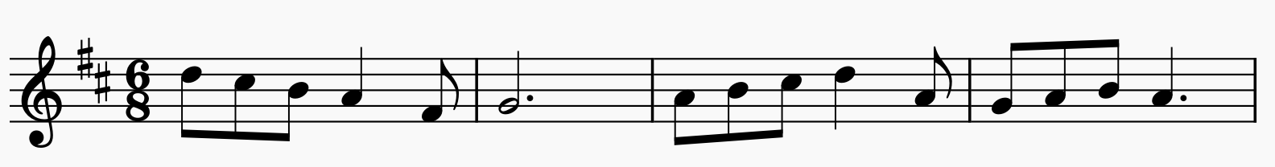

The demisemiquaver
Number of beats
1 2 1 2 1 2 1 2
Type of beat

Slide 9
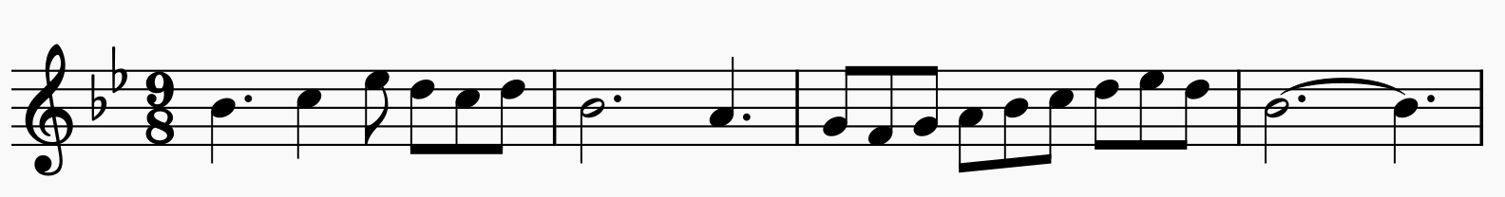
The demisemiquaver
Number of beats
1 2 3 1 2 3 1 2 3 1 2 3
Type of beat

Slide 10
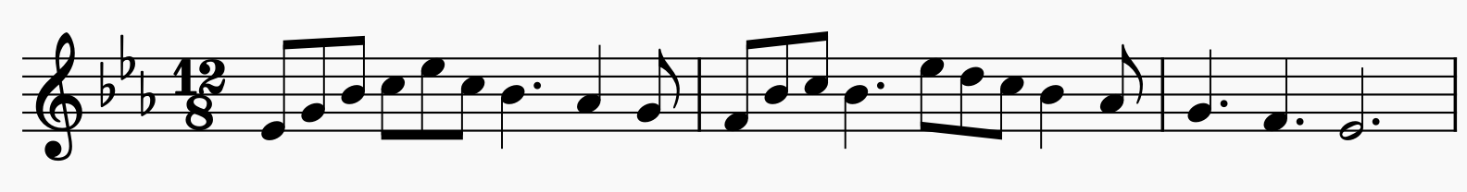
The demisemiquaver
Number of beats
1 2 3 4 1 2 3 4 1 2 3 4
Type of beat
Notice that a dotted minim is equal to 2 dotted crotchet beats. Avoid using ties where not necessary.

Slide 11
Answer the questions below:
What is the time signature for 3 dotted-crotchets beats in a bar?
How many dotted-crotchet beats are there in 12/8 time?
How many quavers are there in 9/8 time?
How do you differentiate simple time signature from compound time?
What is the time signature for two dotted-crotchets beats in a bar?
How many dotted-crotchet beats are there in 6/8 time?

Slide 12
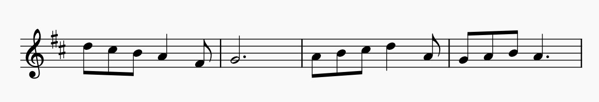
What is the time signature of the melody below?
The time signature is 6/8. Two dotted-crotchets in each bar

Slide 13
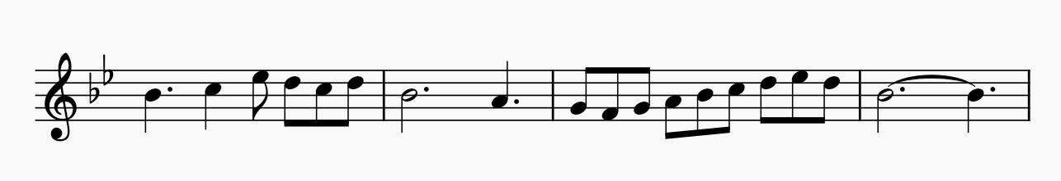
What is the time signature of the melody below?
The time signature is 9/8. Three dotted-crotchets in each bar

Slide 14
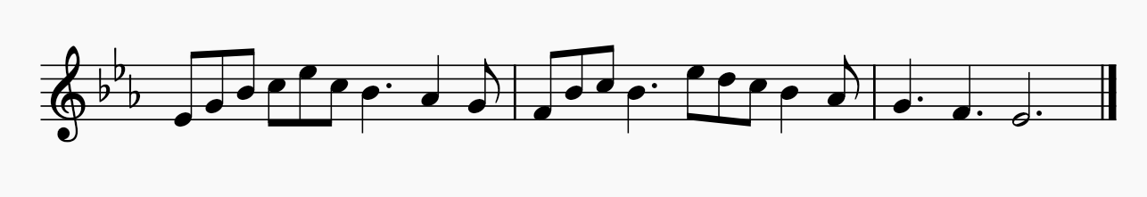
What is the time signature of the melody below?
The time signature is 12/8. Four dotted-crotchets in each bar

Slide 15
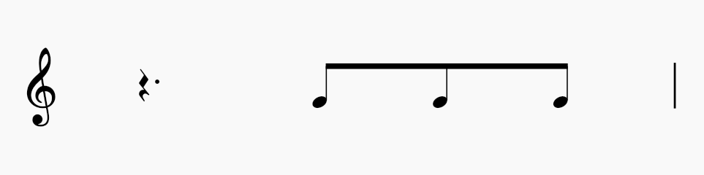
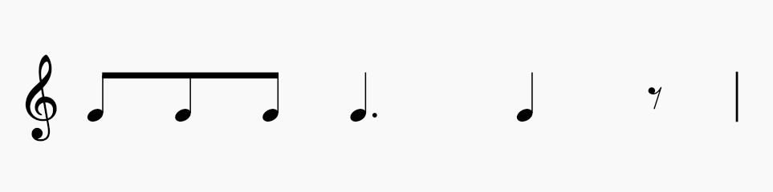
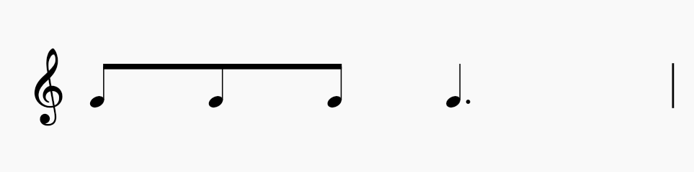
Find the correct time signatures for the rhythms below
6
8
9
8
6
8

Slide 16
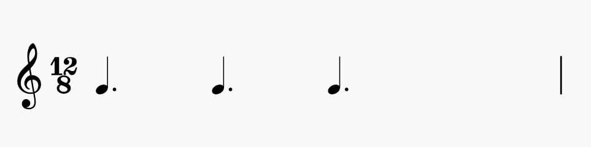
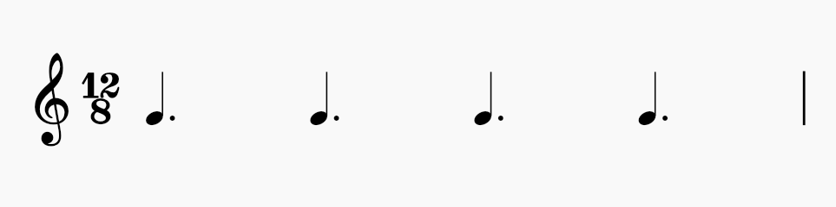
Which note should be added in the rectangle to complete the bar?

Slide 17
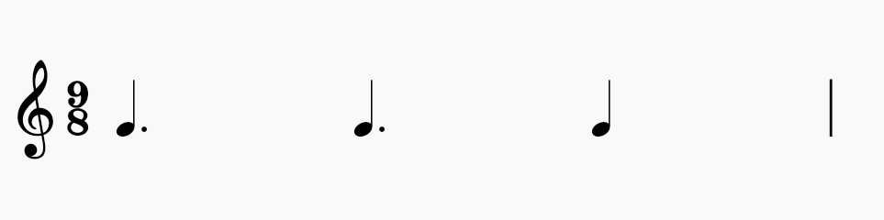
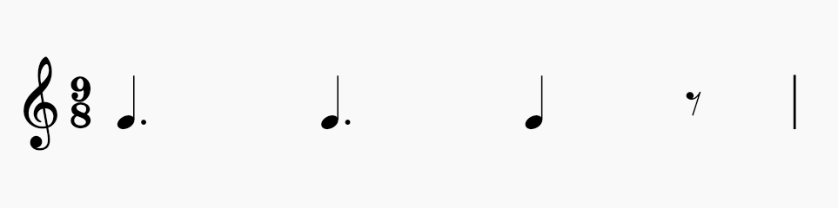
Which note should be added in the rectangle to complete the bar?

Slide 18
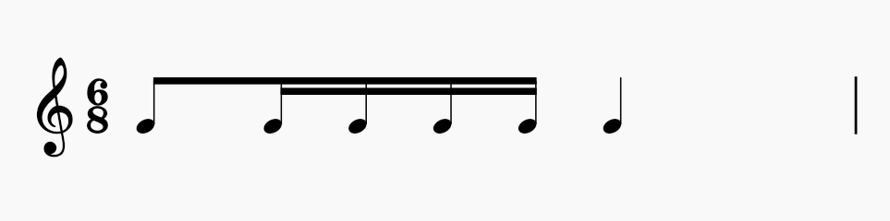
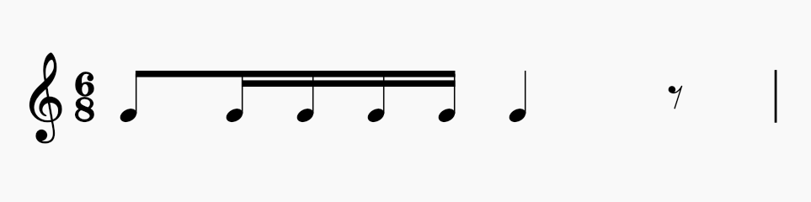
Which note should be added in the rectangle to complete the bar?

Slide 19
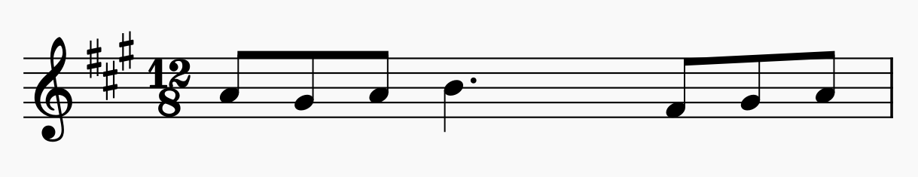
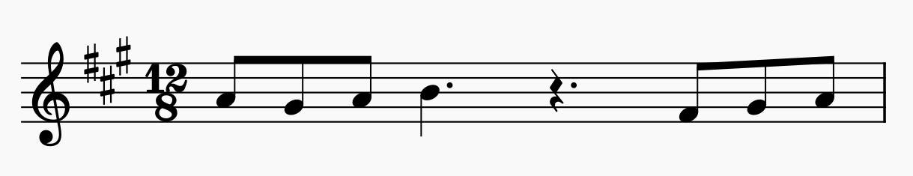
Which (one) rest should be added in the rectangle to complete the bar?

Slide 20
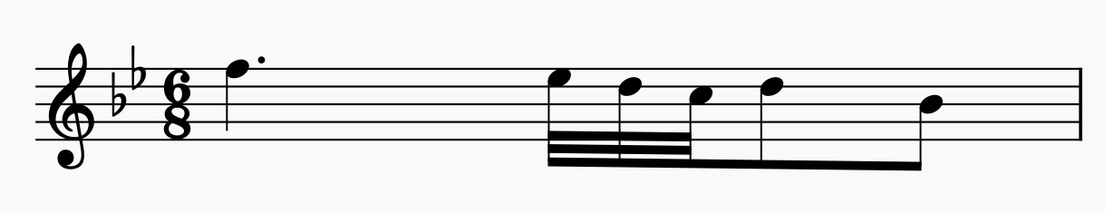
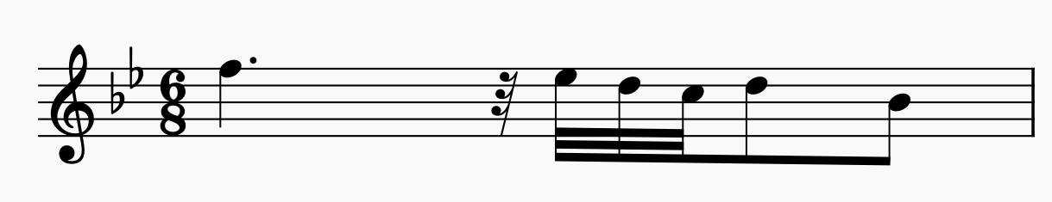
Which (one) rest should be added in the rectangle to complete the bar?

Slide 21
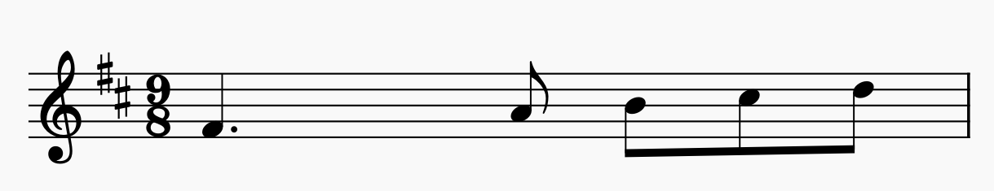
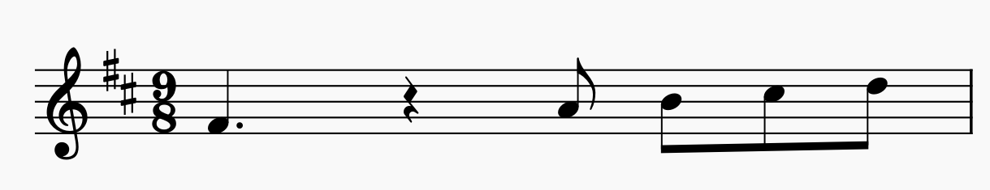
Which (one) rest should be added in the rectangle to complete the bar?

Slide 22
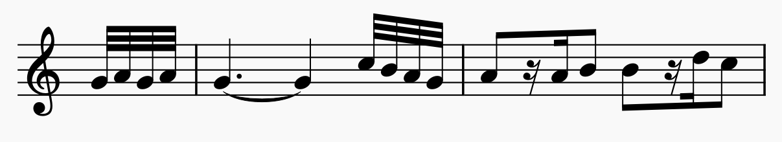
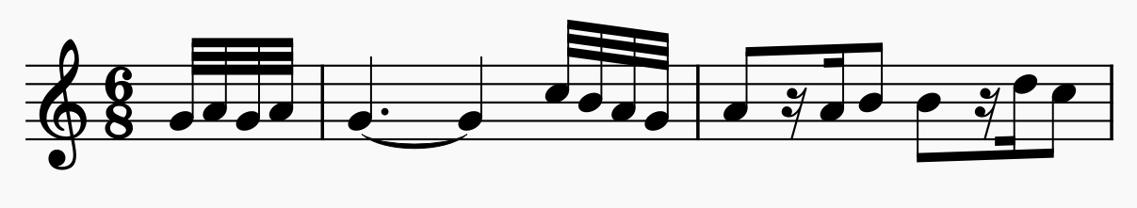
What is the time signature of the melody below?

Slide 23
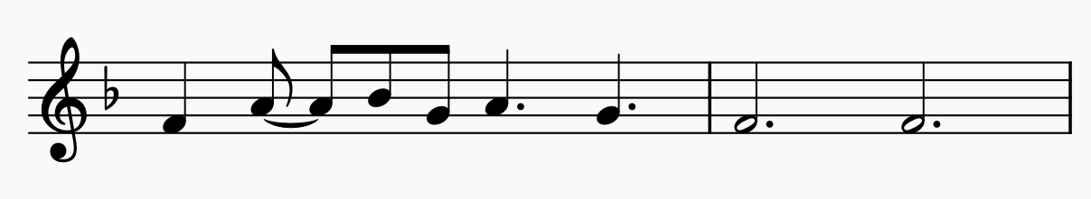
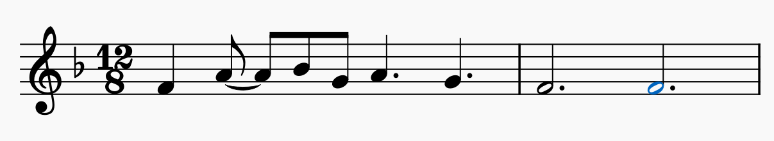
What is the time signature of the melody below?

Slide 24
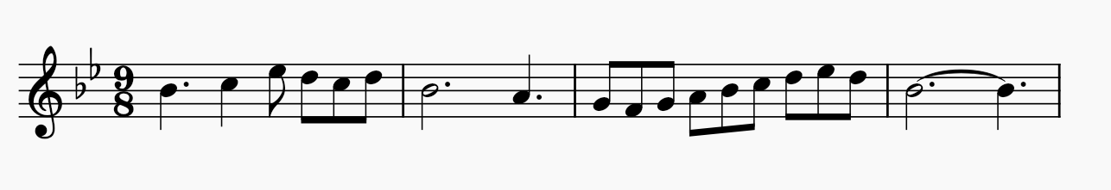
Grouping notes in compound time
In compound time, notes are grouped to show the beats, just like in simple time. The following, however, should be noted:
Beams: Notes are always beamed to make dotted-crotchet beats.
Multiple beats are NOT beamed together

Slide 25
Grouping notes in compound time
In compound time, notes are grouped to show the beats, just like in simple time. The following, however, should be noted:
Ties: Ties are used to join notes that go across different beats, but not to join the notes within a beat
Two full beats are written as a dotted minim.

Slide 26
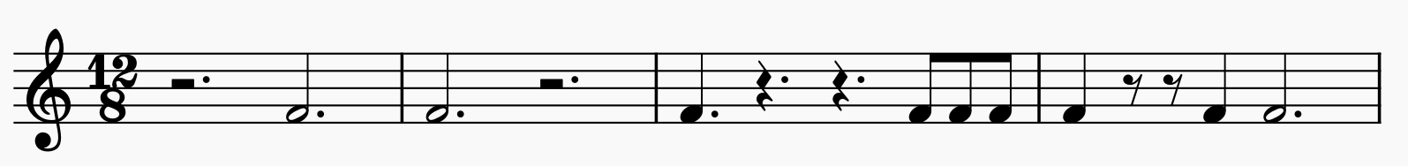
Grouping rests in compound time
In compound time, each new silent beat is given a new rest, just like in simple time. The following, however, is an exception:
In 12/8, use a dotted minim rest for the first two or last two beats of the bar, but not across the middle of the bar
If two last quavers of a beat are silent, two quaver rests are used.

Slide 27
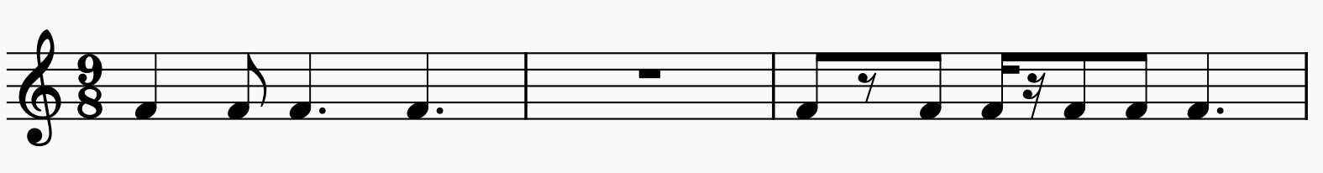
Grouping rests in compound time
In compound time, each new silent beat is given a new rest, just like in simple time. The following, however, is an exception:
A completely silent bar will use a semibreve rest.

Slide 28
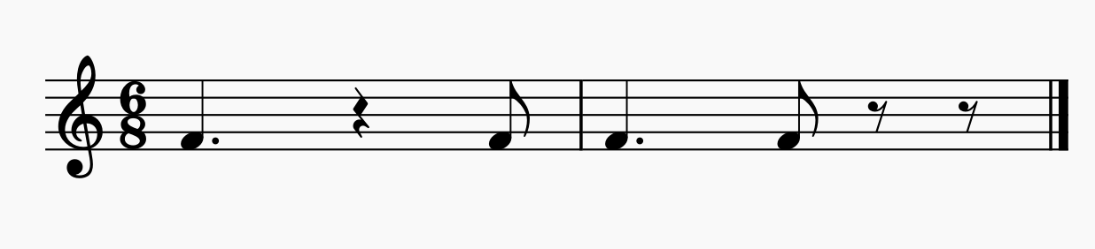
Grouping of rests in compound time
If the first two quavers in a beat are silent, use crotchet rest.
If the second two are silent, use two quaver rests as illustrated above.

Slide 29
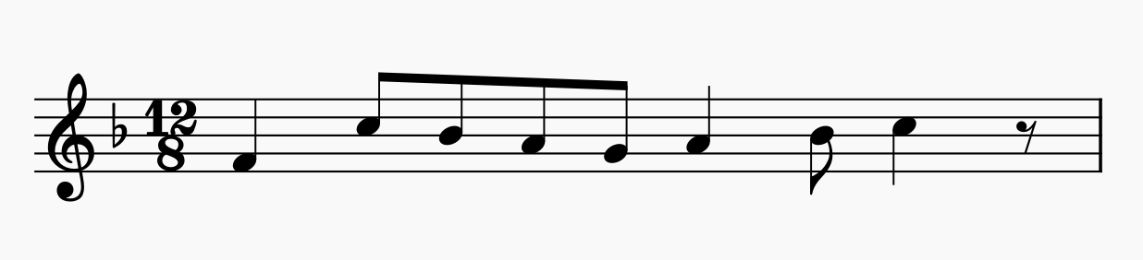
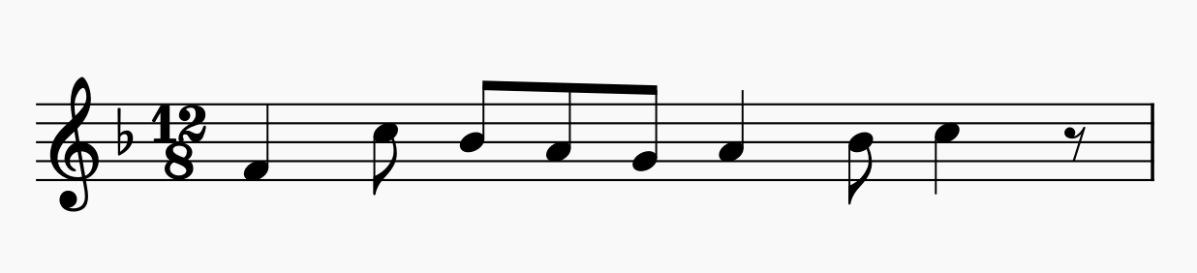
Is the following bar grouped correctly?
NO. Part of the first beat is grouped with the second beat.

Slide 30
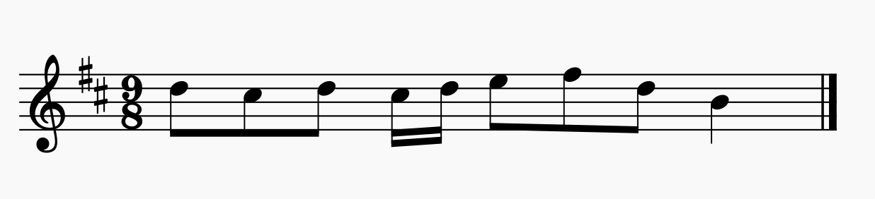
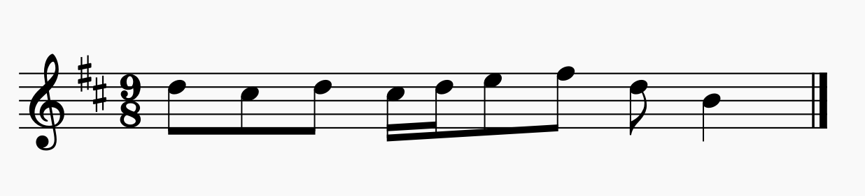
Is the following bar grouped correctly?
NO. The second and third beats are not grouped correctly.

Slide 31
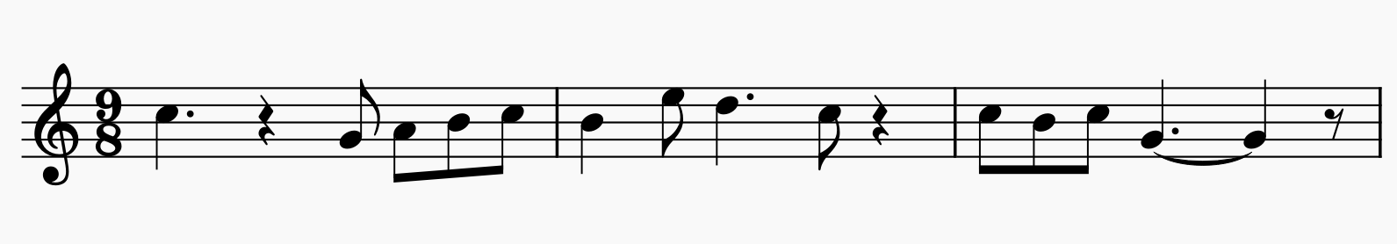
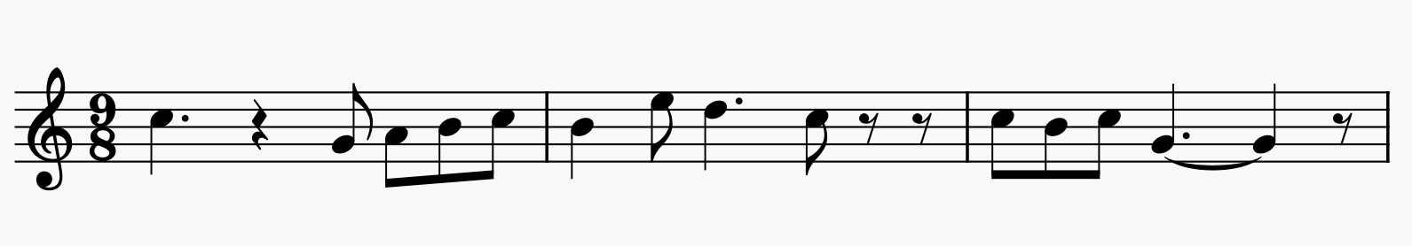
Which bar in the following melody is NOT grouped correctly?
The second bar. When the last two quavers of a dotted-crotchet beat are silent, use two quaver rests instead of crotchet rest:

Slide 32
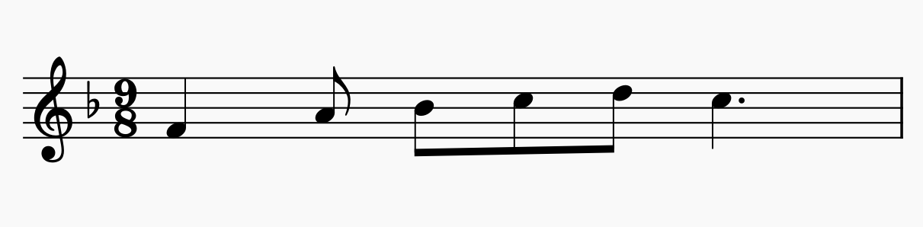
Is the following bar in simple or compound time? Duple, Triple or quadruple?
This is in compound triple time
It has 3 dotted crotchet beats in a bar

Slide 33
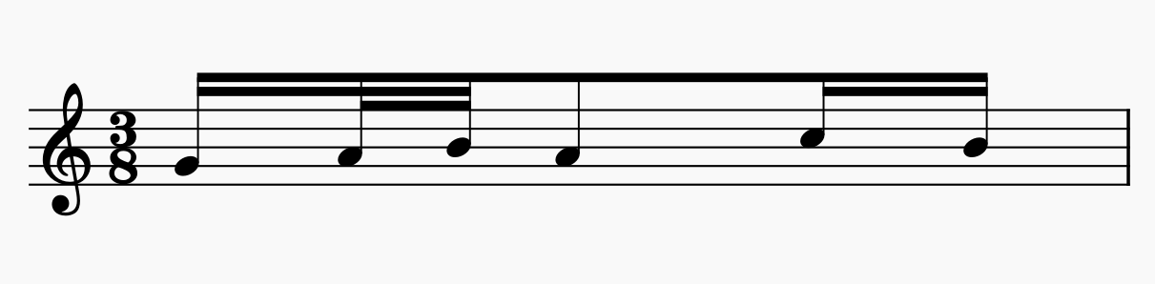
Is the following bar in simple or compound time? Duple, Triple or quadruple?
This is in simple triple time
It has 3 quaver beats in a bar

Slide 34
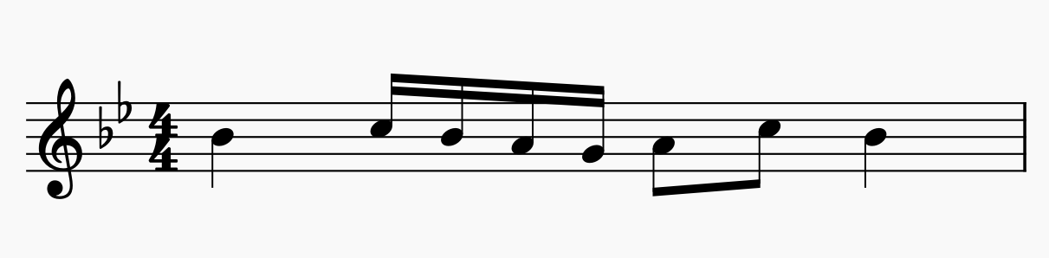
Is the following bar in simple or compound time? Duple, Triple or quadruple?
This is in simple quadruple time
It has 4 crotchet beats in the bar

Slide 35
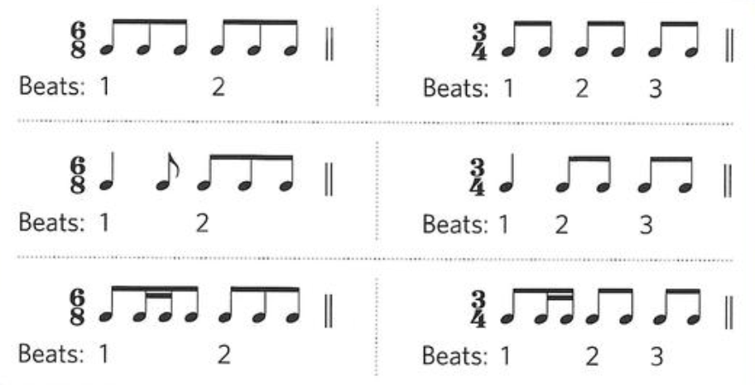
Differentiate the grouping in the following 9/8 and 3/4 bars containing the same notes in the bar:

Slide 36
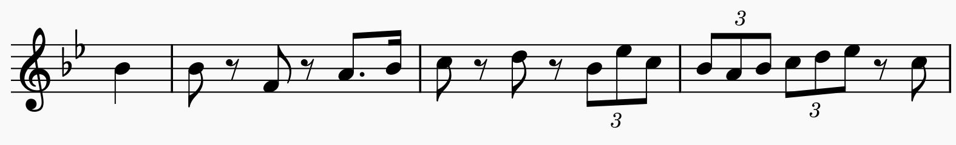
Is the following bar in 3/4 or 6/8?
This is in 3/4
The grouping is done in crotchet beats, not dotted crotchets.
Remember triplets are done in time of two of the same value.

Slide 37
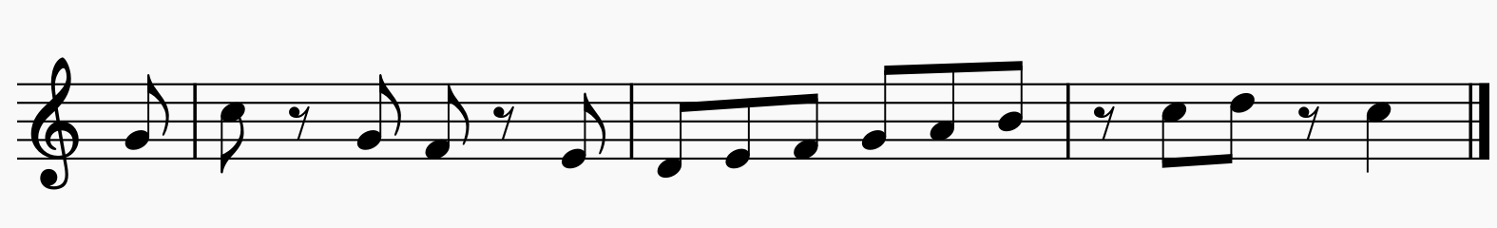
Is the following bar in 3/4 or 6/8?
This is in 6/8
The grouping is done in dotted-crotchet beats, not crotchets.

Slide 38
Thank you, Friends
Quiz: www.chezamusicschool.co.ke/mtg3l2

