Slide 1

LESSON 4
Music Theory G1
Quiz: www.chezamusicschool.co.ke/mtg1l4

Slide 2
CONTENTS
Rhythm
01
02
Pitch
Rhythm 2
03
04
Pitch 2

Slide 3
CONTENTS
Rhythm 3
05
06
Scales
Keys & Key Signatures
07
08
Intervals

Slide 4
CONTENTS
Tonic Triads
09
10
Terms & Signs

Slide 5
06B
Scales
Grade 1
F MAJOR
G MAJOR
D MAJOR

Slide 6


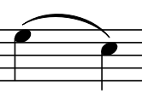
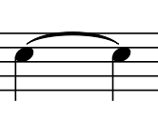







Terms & Signs for the day:
Gradually getting louder (crescendo)
                cantabile - in a singing style
                da capo (D.C.)- go back to beginning
                dolce - sweet
                fine - end
legato - Smoothly
staccato (stacc.)- gradually getting quicker
Gradually getting quieter (diminuendo)
slur - perform smoothly
tie - hold for the value of
the two notes.
Fermata - pause on the note
or rest
Metronome mark: Play at a
tempo of 80 crotchet beats
per minute
staccato; detatched
Accent the note - play with
emphasis
Repeat the section between
the two marks

Slide 7
G Major, D Major and F Major Scale
The scales of G, D and F major all follow the same pattern of tones and semitones as C major -
Tone, Tone, Semitone, Tone, Tone, Tone Semitone

Slide 8
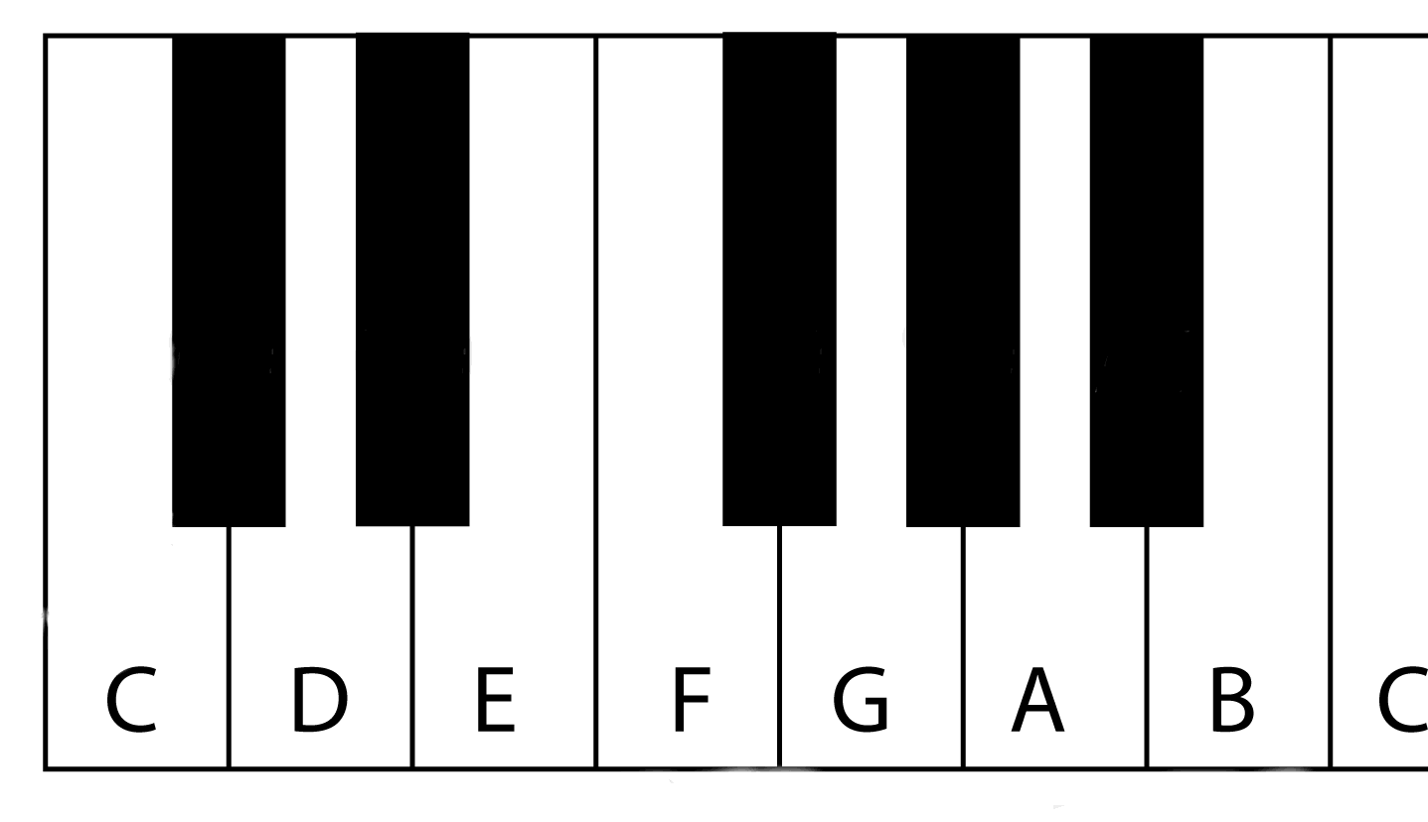
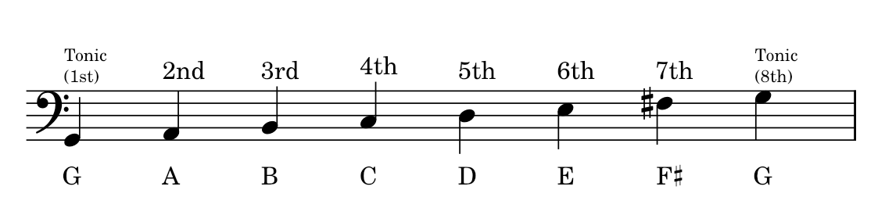
G Major Scale
Tone
Tone
Semitone
Tone
Tone
Tone
Semitone
An F# is required in G Major, to make the pattern of tones and semitones correct. Without an F#, there would be a semitone between the 6th and 7th degrees instead of between the 7th and 8th degrees.

Slide 9
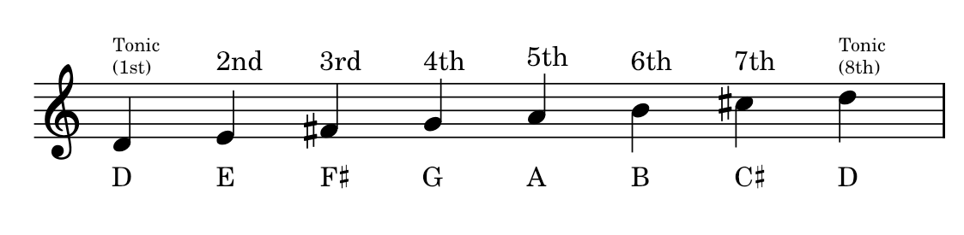
D Major Scale
Tone
Tone
Semitone
Tone
Tone
Tone
Semitone
In D major, two accidentals - F# and C# are needed to keep the same pattern of tones and semitones.

Slide 10
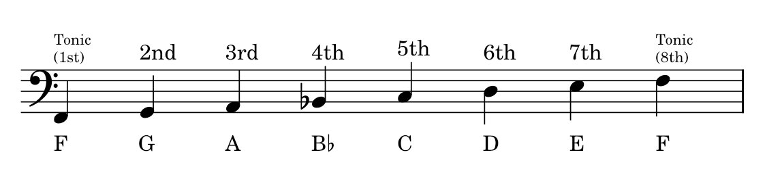
D Major Scale
Tone
Tone
Semitone
Tone
Tone
Tone
Semitone
In F major, we need a B flat to keep the semitone between the 3rd and 4th degrees.

Slide 11
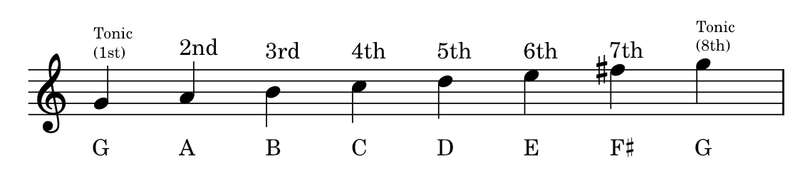
Review
What is the letter name of the the first / last degree of the scale of G major?
Why is the F raised to F Sharp?
Which note is the 3rd degree of G major?
Which note is the 7th degree of G major?

Slide 12
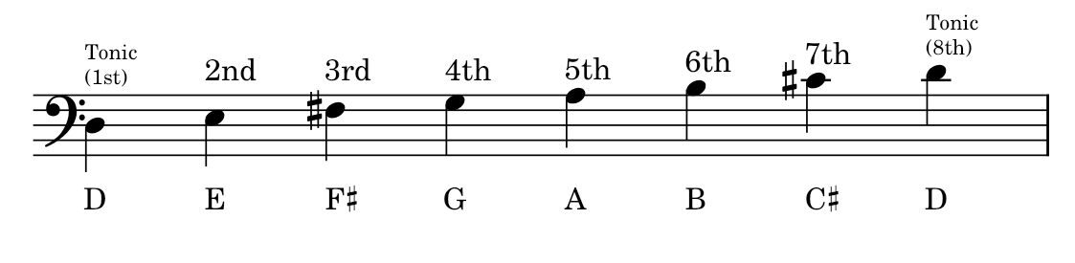
Review
What is the letter name of the the first / last degree of the scale of D major?
Why is the C raised to C Sharp?
Which note is the 5rd degree of D major?
Which note is the 2nd degree of D major?
How many sharps does the scale of D major have?

Slide 13
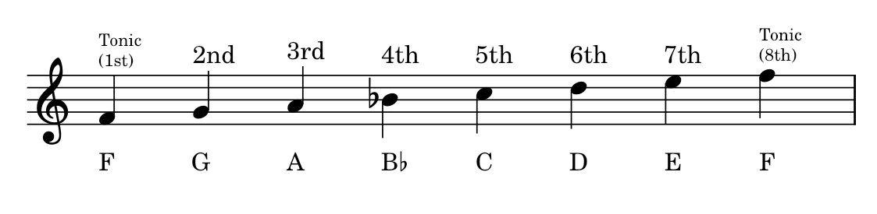
Review
What is the letter name of the the first / last degree of the scale of F major?
Why is the B flattened to B flat?
Which note is the 4th degree of F major?
Which note is the 6th degree of F major?
How many sharps does the scale of F major have?
How many semitones does the scale of F major have?

Slide 14
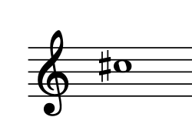
Review
Which degree of D major is this?
7th degree

Slide 15
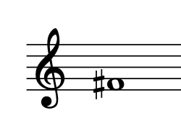
Review
Which degree of G major is this?
7th degree

Slide 16
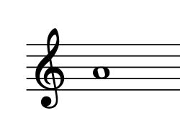
Review
Which degree of C major is this?
6th degree

Slide 17
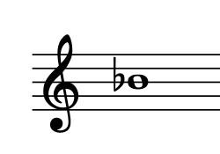
Review
Which degree of F major is this?
4th degree

Slide 18
Review
Which degree of D major is this?
3rd degree

Slide 19
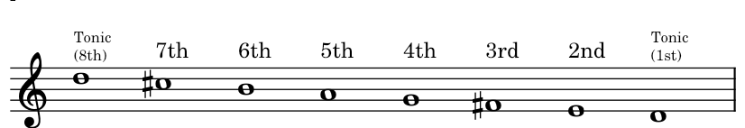
Review
Which key is the scale above in?
D Major descending

Slide 20
07
Keys and Key Signatures
Grade 1
KEYS
KEY SIGNATURES
MORE ON ACCIDENTALS

Slide 21
Keys
We have learned about the scales of C, G, D, and F major.
Each of these scales contains all the notes that belong in that key.
Each key has its own tonic and the tonic is the name of the key. For example, the key of F has note F as its tonic.
A melody that is written in a particular key uses notes from the scale of that key.
Each key has its unique features. The number of accidentals (and specifically which accidentals) are what we use to determine which key a melody is in.

Slide 22
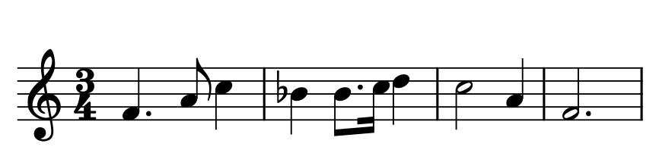
Review
Name the key of the melody above.
Tip: A melody that is written in a particular key uses notes from the scale of that key.
Which key has a scale with B flat?

Slide 23
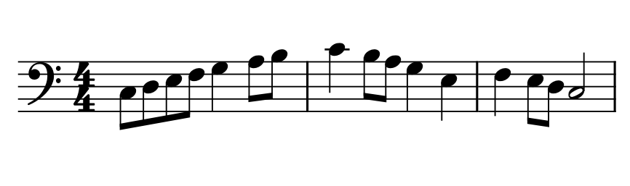
Review
Name the key of the melody above.
Tip: A melody that is written in a particular key uses notes from the scale of that key.
Which key has a scale that has got no accidental?

Slide 24
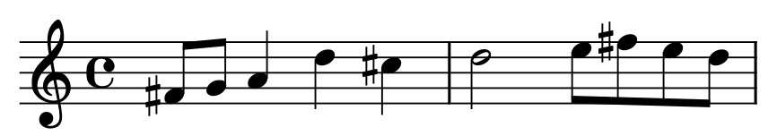
Review
Name the key of the melody above.
Tip: A melody that is written in a particular key uses notes from the scale of that key.
Which key has a scale that has F# and C#?

Slide 25
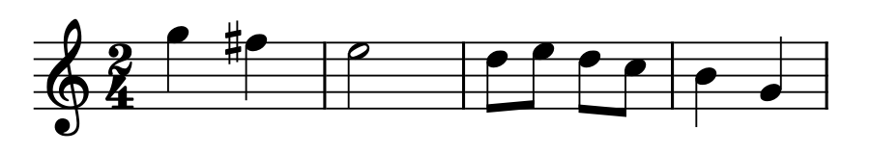
Review
Name the key of the melody above.
Tip: A melody that is written in a particular key uses notes from the scale of that key.
Which key has a scale that has F#?

Slide 26
Key Signature
A key signature is written at the start of the stave after the clef but before the time signature.
It tells us the key of a piece by showing which notes will be sharpened or flattened.
Using a key signature means we don’t have to keep writing accidentals for the sharps and flats in that key.
A sharp of flat in a key signature applies to every note of that name, wherever it is on the stave.
The sharps and flats are written in a specific order and only on the lines or spaces with the notes that should be sharpened or flattened.

Slide 27
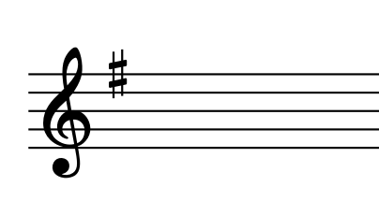
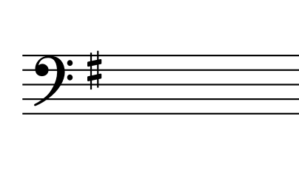
Review
Below is a key signature of a certain key
Guess the key represented by the key signature above.
The key signature has got one sharp on F.
The key is G major

Slide 28
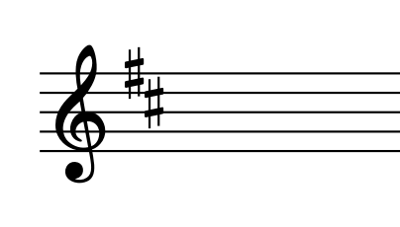
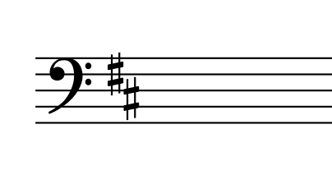
Review
Below is a key signature of a certain key
Guess the key represented by the key signature above.
The key signature has got two sharps on F and C.
The key is D major

Slide 29
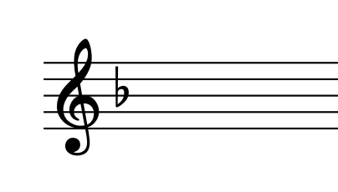
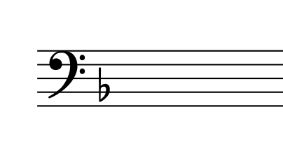
Review
Below is a key signature of a certain key
Guess the key represented by the key signature above.
The key signature has got one flat on B.
The key is F major

Slide 30
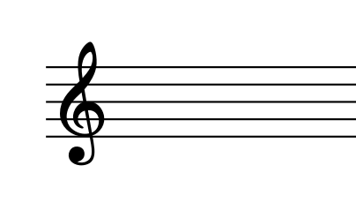
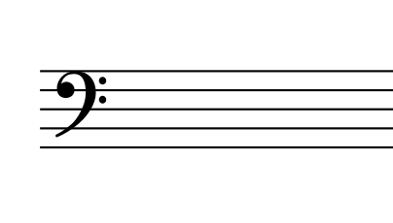
Review
Below is a key signature of a certain key
Guess the key represented by the key signature above.
The key signature has got no sharps and no flats
The key is C major

Slide 31
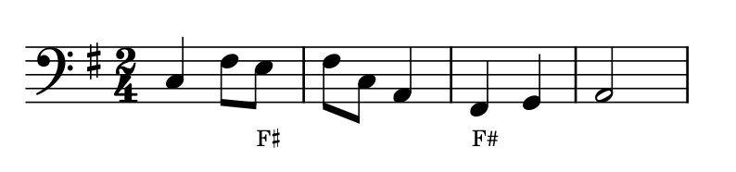
Key signatures
The sharp in the key signature (on line F) turns every F into an F sharp.

Slide 32
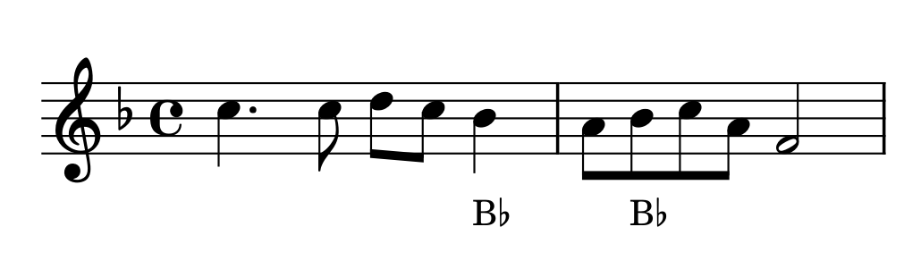
Key signatures
The flat in the key signature (on line B) turns every B in the piece of music into B flat.

Slide 33
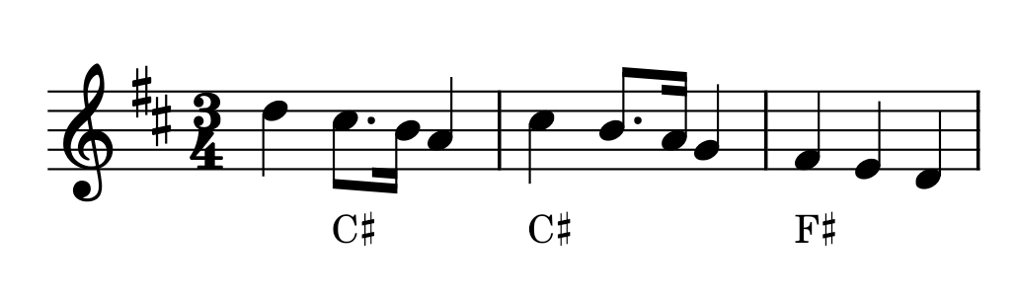
Key signatures
The sharps in the key signature (on line F and space C) turns every F into an F sharp, and every C into C sharp

Slide 34
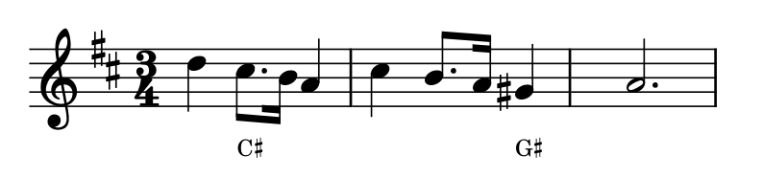
More on accidentals
Even with the key signatures, sometimes accidentals will be needed in the music. This happens when the music uses notes outside of its scale notes.
In the above melody, G sharp is written as an accidental because it is not part of the key signature of D major.

Slide 35
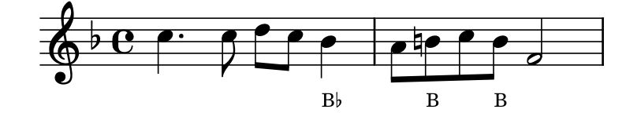
More on accidentals
Remember that accidentals last until the end of the bar, unless they are cancelled by another accidental.
Also remember that accidental apply only to notes of the same pitch
The natural in the second bar cancels the flat in the time signature.
The second B is also B natural because it is in the same bar and same pitch as the first B natural.

Slide 36
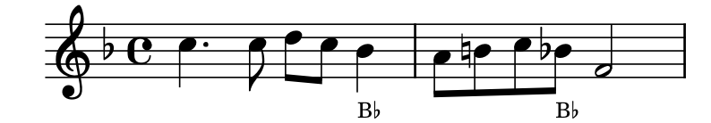
More on accidentals
Remember that accidentals last until the end of the bar, unless they are cancelled by another accidental.
Also remember that accidental apply only to notes of the same pitch
The natural in the second bar cancels the flat in the time signature.
The second B is B flat because it the flat cancels the natural that occured earlier in the same bar.

Slide 37
08
Intervals and Tonic Triads
Grade 1
INTERVALS
TONIC TRIADS

Slide 38
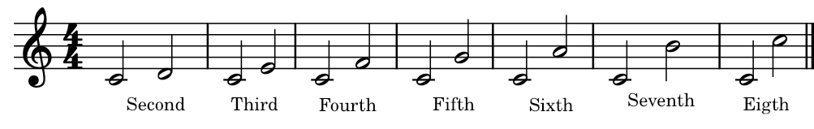
Intervals
An interval measures the difference in pitch between two notes.
We can use the degrees of the scale to measure the intervals between the tonic of a key and every other note in that key.
Below are intervals above the tonic in C major:

Slide 39
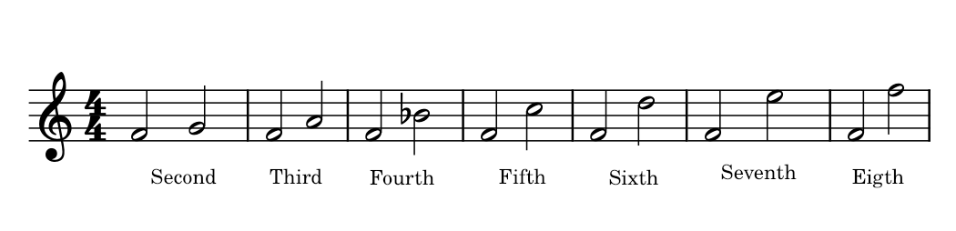
Intervals
To which key does the intervals above belong?
F Major

Slide 40
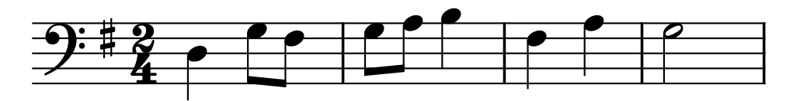
Intervals
Identify the intervals marked by brackets.
4th
2nd
3rd

Slide 41
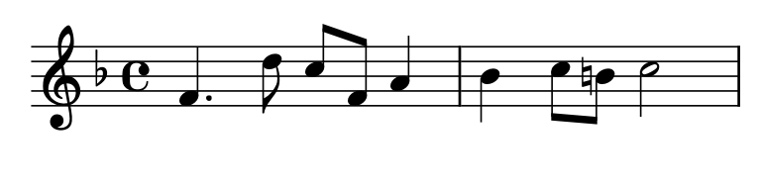
Intervals
Identify the intervals marked by brackets.
4th
5th
2nd
6th

Slide 42
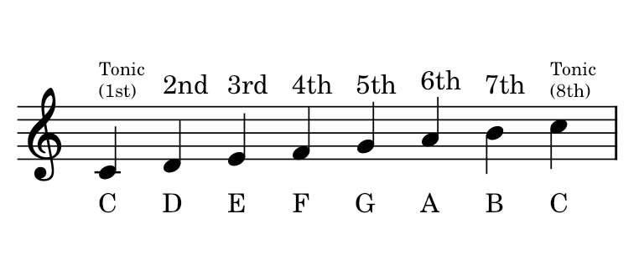
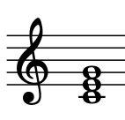
Tonic Triads
A tonic triad is a chord made up of three notes.
The notes are the first, third and the fifth degrees of the scale.

Slide 43
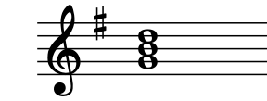
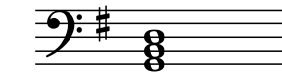
Tonic triads
The tonic triads above are for G major. They include the 1st degree, 3rd degree and 5th degree of G major

Slide 44
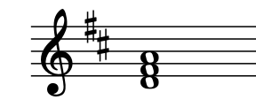
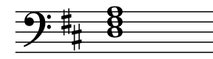
Tonic triads
The tonic triads above are for D major. They include the 1st degree, 3rd degree and 5th degree of D major

Slide 45
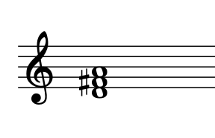
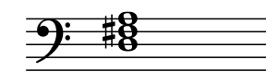
Tonic triads
The tonic triads above are for D major. They include the 1st degree, 3rd degree and 5th degree of D major
In the above example, the key signature is not used, so the F has an accidental.

Slide 46
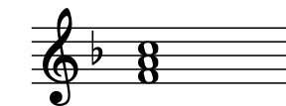
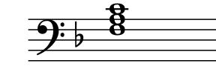
Tonic triads
The tonic triads above are for F major. They include the 1st degree, 3rd degree and 5th degree of F major

Slide 47
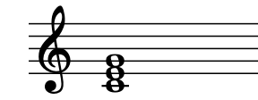
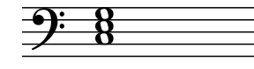
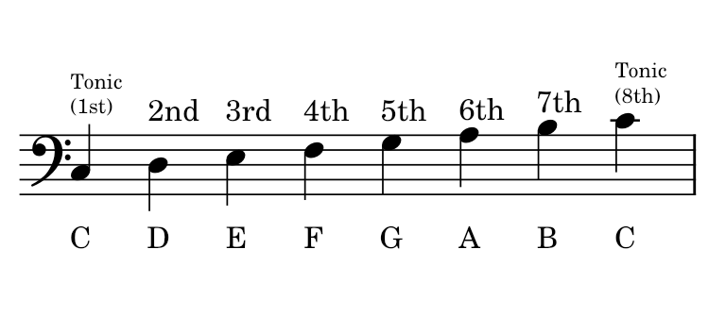
Tonic triads
The tonic triads above are for C major. They include the 1st degree, 3rd degree and 5th degree of C major

Slide 48
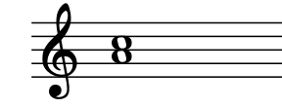

Review
Which note is mising here to make a tonic triad of F major?
F

Slide 49

Review
Which note is mising here to make a tonic triad of D major?
F#

Slide 50
Thank you, Friends
Quiz: www.chezamusicschool.co.ke/mtg1l4

