Slide 1

LESSON 5
Music Theory G2
Quiz: www.chezamusicschool.co.ke/mtg2l5

Slide 2
CONTENTS
Pitch
01
02
Rhythm 1
Rhythm 2
03
04
Rhythm 3

Slide 3
CONTENTS
Keys & Scales 1
05
06
Keys & Scales 2
Intervals
07
08
Tonic Triads

Slide 4
CONTENTS
Terms and Signs
09

Slide 5
Terms & Signs for the day:
We have covered all the terms and signs for grade 2. Can you remember them? Test yourself at https://gb.abrsm.org/en/our-exams/online-theory/music-theory-quiz/
In that page, scroll down, click on grade 2 and try out the quiz.

Slide 6
06
Keys and Scales 2
Grade 2
INTERVALS
TONIC TRIADS

Slide 7
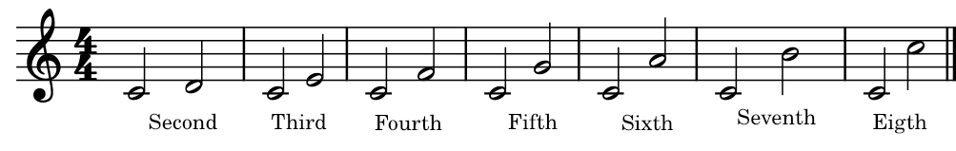
Reminder:
An interval measures the difference in pitch between two notes.
To measure an interval, we count up in degrees from the lower to the higher note.
Below are intervals above the tonic in C major:

Slide 8
Relative majors and minors
In grade 2, the lower note of every interval will always be the key note.
It doesn’t matter if the higher note is sharpened, the interval remains the same.
Intervals may appear with the higher note first, but we still count up from the lower note.

Slide 9
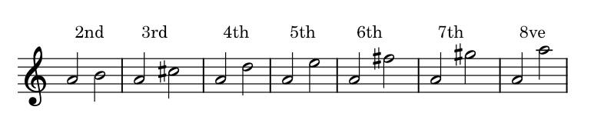
Intervals
Which key has the intervals shown above?
A major written without key signature.
Which degrees of A major are sharpened?

Slide 10
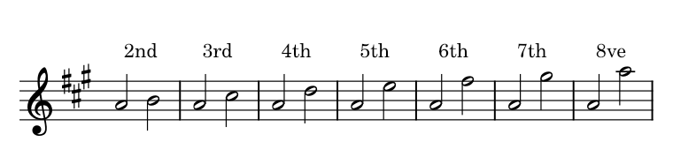
A major intervals with key signature
With key signatures, we don’t need accidentals when writing intervals
Can you still see which degrees are sharpened?

Slide 11
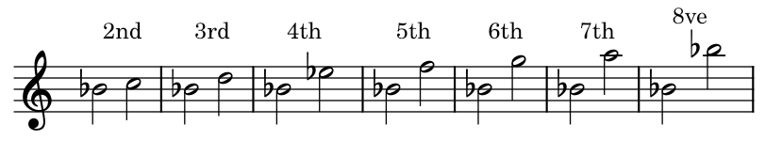
Intervals
Which key has the intervals shown above?
B flat major written without key signature.
Which degrees of B flat major are flattened?

Slide 12
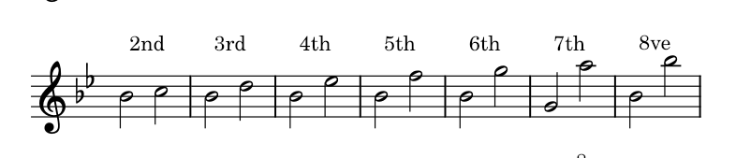
B flat major intervals with key signature
With key signatures, we don’t need accidentals when writing intervals
Can you still see which degrees are flattened?

Slide 13
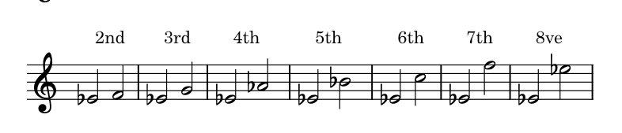
Intervals
Which key has the intervals shown above?
E flat major written without key signature.
Which degrees of E flat major are flattened?

Slide 14
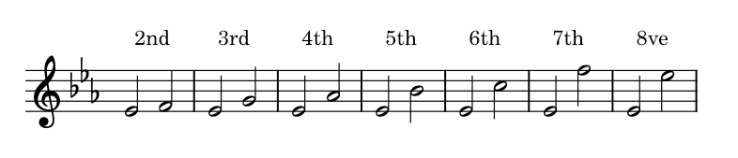
E flat major intervals with key signature
With key signatures, we don’t need accidentals when writing intervals
Can you still see which degrees are flattened?

Slide 15
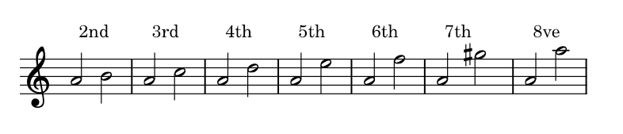
Intervals
Which key has the intervals shown above?
A minor.
Which degrees of A minor are raised?

Slide 16
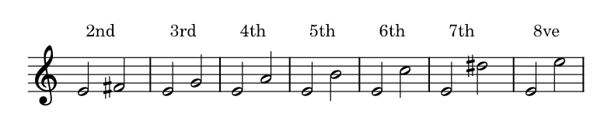
Intervals
Which key has the intervals shown above?
E minor written without key signature.
Which degrees of E minor are raised?

Slide 17
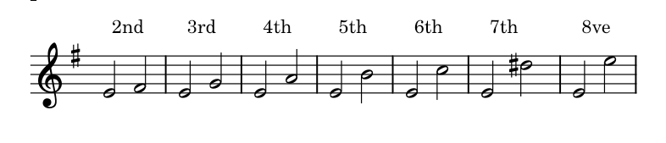
E minor intervals with key signature
With key signatures, we don’t need accidentals when writing intervals
The raised 7th degree in a minor key, however, should always be there.
Can you still see which degrees are raised by the key signature?

Slide 18
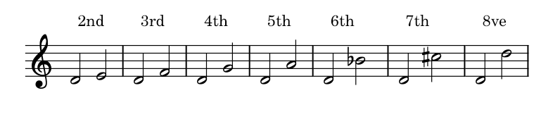
Intervals
Which key has the intervals shown above?
D minor written without key signature.
Which degrees of E minor are raised?

Slide 19
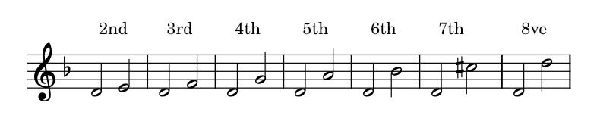
E minor intervals with key signature
With key signatures, we don’t need accidentals when writing intervals
The raised 7th degree in a minor key, however, should always be there.
Can you still see which degrees are lowered by the key signature?

Slide 20
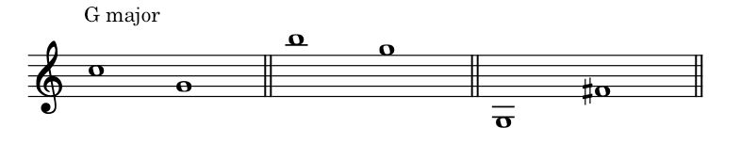
Identify these intervals above the tonic
4th
3rd
7th

Slide 21
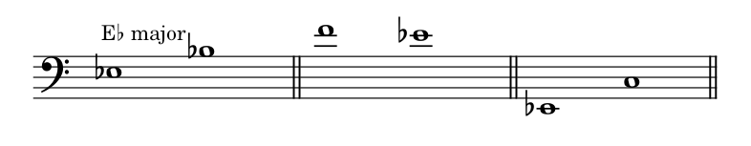
Identify these intervals above the tonic
5th
2nd
6th

Slide 22
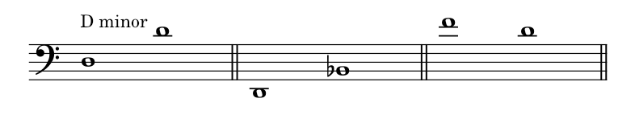
Identify these intervals above the tonic
8ve
6th
3rd

Slide 23
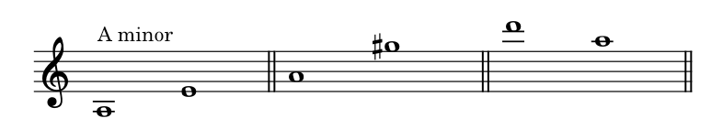
Identify these intervals above the tonic
5th
7th
4th

Slide 24
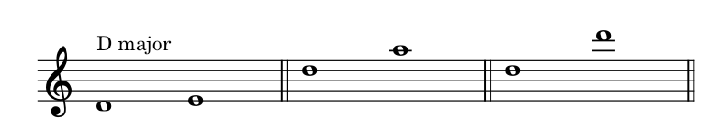
Identify these intervals above the tonic
2nd
5th
8ve

Slide 25
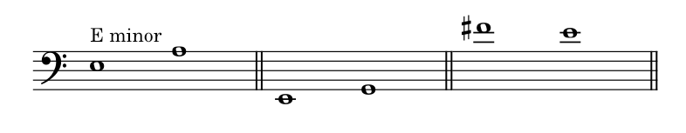
Identify these intervals above the tonic
4th
3rd
2nd

Slide 26
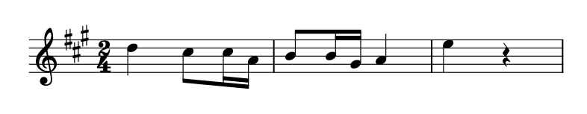
Identify intervals shown by brackets
The lower note of every interval is the tonic
3rd
5th

Slide 27
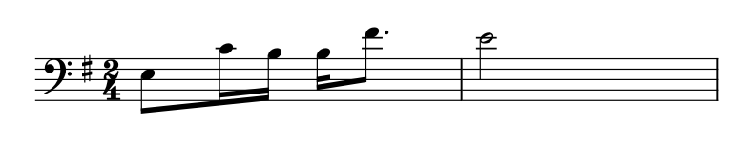
Identify intervals shown by brackets
The lower note of every interval is the tonic
6th
2nd

Slide 28
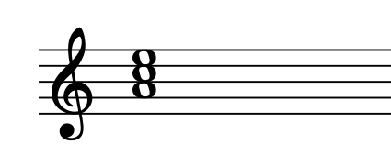
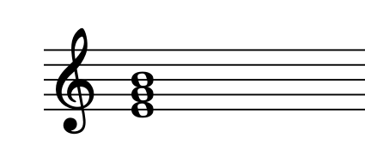
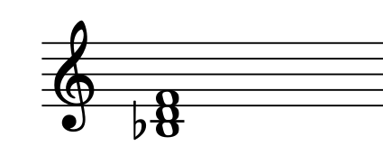
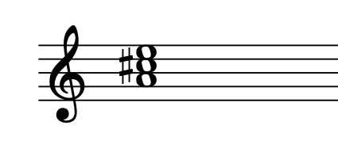
Name the key of each tonic triad below
A minor
E minor
B flat major
A major

Slide 29
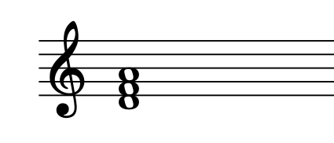
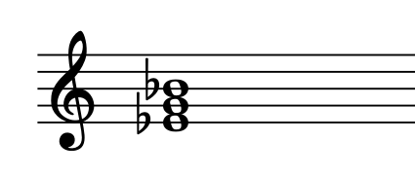
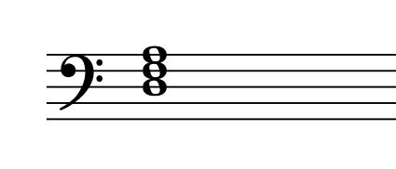
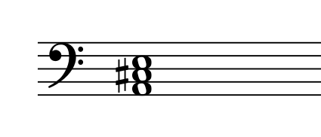
Name the key of each tonic triad below
D minor
E flat major
D minor
A major

Slide 30
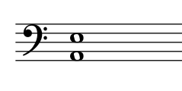
Which note is missing to make this a tonic triad
of A major?

Slide 31
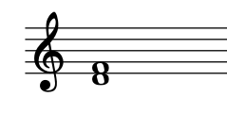
Which note is missing to make this a tonic triad
of B flat major?

Slide 32
Thank you, Friends
Quiz: www.chezamusicschool.co.ke/mtg2l5

