Slide 1

LESSON 4
Music Theory G2
Quiz: www.chezamusicschool.co.ke/mtg2l4

Slide 2
CONTENTS
Pitch
01
02
Rhythm 1
Rhythm 2
03
04
Rhythm 3

Slide 3
CONTENTS
Keys & Scales 1
05
06
Keys & Scales 2
Intervals
07
08
Tonic Triads

Slide 4
CONTENTS
Terms and Signs
09

Slide 5



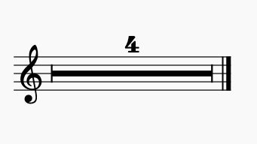

Terms & Signs for the day:
Perform an octave higher
First-time bar (in a repeated section, play this bar the first time through)
Rest for the number of bars indicated
Second-time bar (in a repeated section, play this bar the second time through)

Slide 6
06
Keys and Scales 2
Grade 2
RELATIVE MAJORS AND MINORS
MINOR SCALES
MINOR SCALES WITH AND WITHOUT KEY SIGNATURES

Slide 7
Relative majors and minors
For every major key, there’s a relative minor key that shares the same key signature. Relative minor keys use many of the same notes as their relative major, but they sound quite different.
The tonic (key note) of a relative minor key is the 6th degree of its relative major.

Slide 8
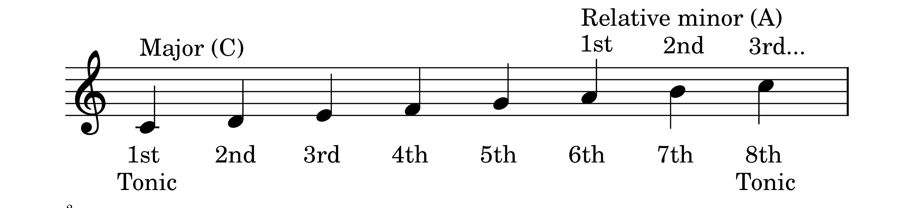
C major and how to get its relative minor:

Slide 9
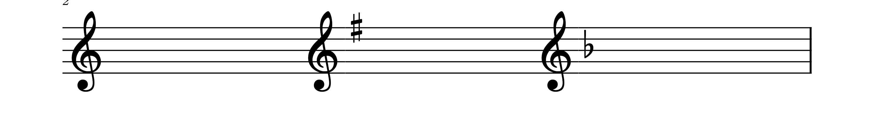
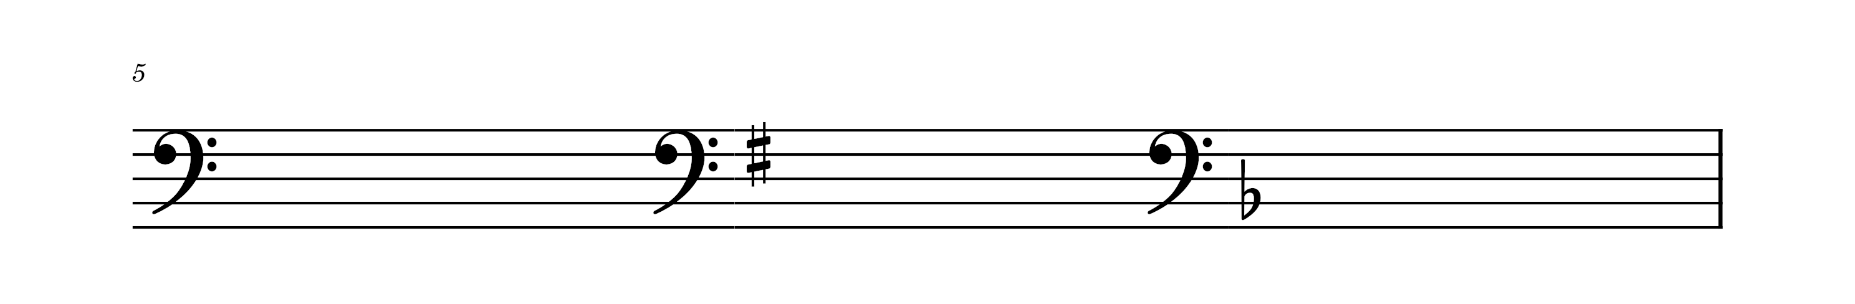
Minor keys in grade 2
When you look at the key signatures above, you probably know the major keys that they represent. Each of the key signatures above, however represent a relative minor key.

Slide 10
Minor keys in grade 2
A minor is the relative minor of C major.
The key signature of A minor and C major have got no sharps or flats.

Slide 11
Minor keys in grade 2
E minor is the relative minor of G major.
The key signature of E minor and G major has
got one sharp on F

Slide 12
Minor keys in grade 2
D minor is the relative minor of F major.
The key signature of D minor and F major has
got one flat on B

Slide 13
Minor scales
One of the minor scale forms is harmonic minor
Harmonic minor scale has the 7th degree raised by a semitone
Remember the 7th degree is of the minor key itself.
Apart from the raised 7th note, the minor key uses the same notes
as its relative major scale

Slide 14
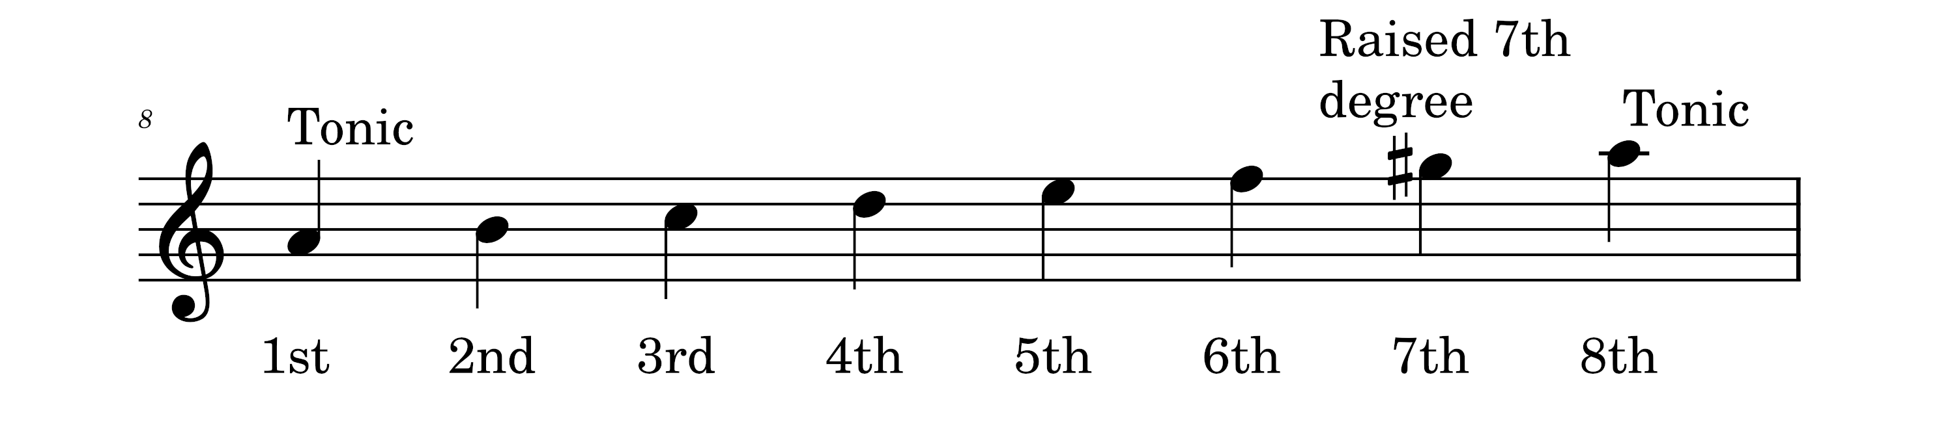
A harmonic minor
There are no sharps or flats in the key signature of A minor
The raised 7th is not in the key signature but is used as an
accidental

Slide 15
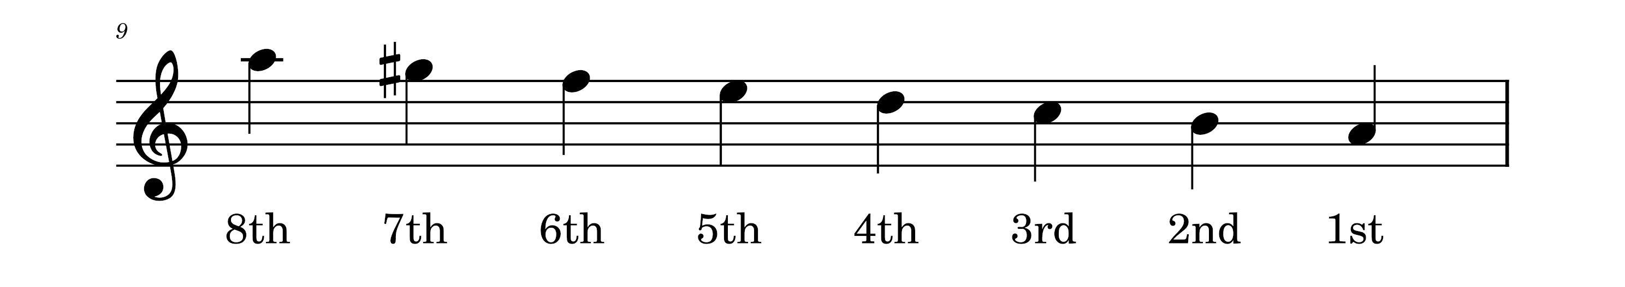
A harmonic minor
The descending scale of A harmonic minor uses the same notes as the
ascending minor scale.

Slide 16
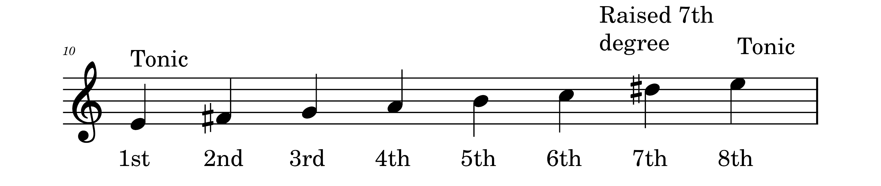
E harmonic minor
There is one sharp in the key signature of E minor
The raised 7th (D#) is not in the key signature but is used as an accidental
The F sharp is part of the key signature

Slide 17
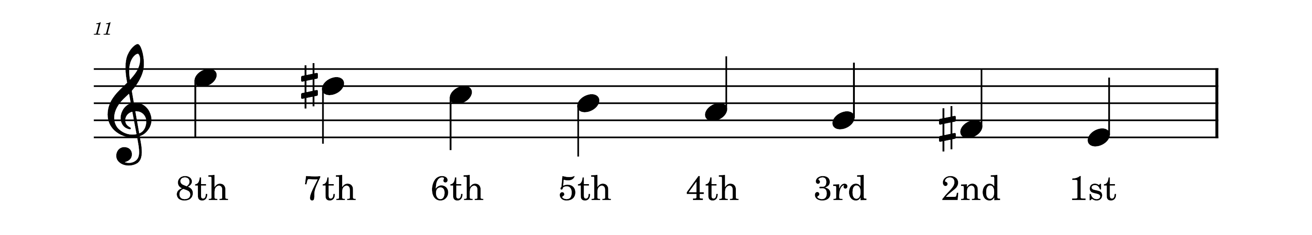
E harmonic minor
The descending scale of E harmonic minor uses the same notes as the
ascending minor scale. Don’t forget that the F sharp is in the key signature.

Slide 18
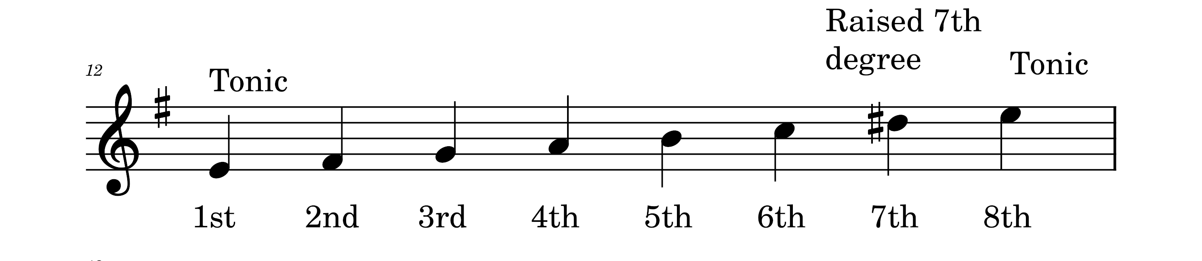
E harmonic minor
The example above uses a key signature.
Do you notice that the F sharp accidental is not used here?
The key signature takes care of the F sharps, but not the D sharp that
is raised as the 7th degree of the minor scale.

Slide 19
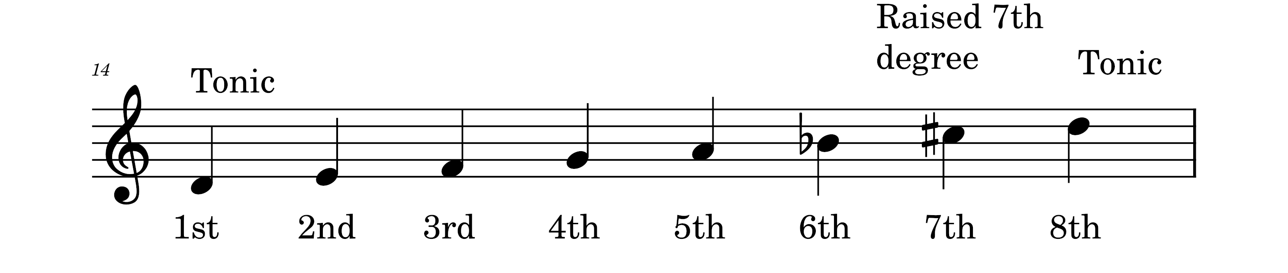
D harmonic minor
There is one flat in the key signature of D minor
The raised 7th (C#) is not in the key signature but is used as an accidental
The B flat is part of the key signature

Slide 20
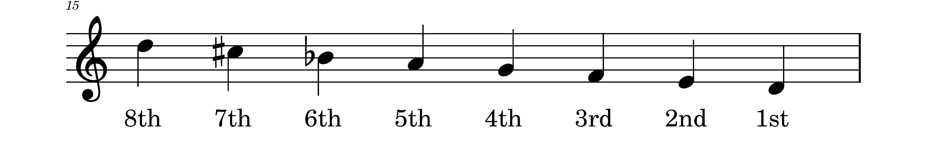
D harmonic minor
The descending scale of D harmonic minor uses the same notes as the
ascending minor scale. Don’t forget that the B flat is in the key signature.

Slide 21
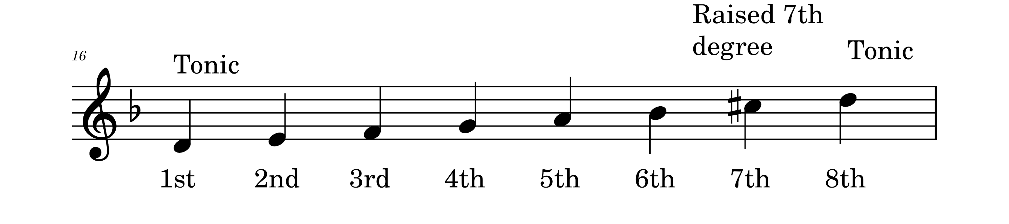
D harmonic minor
The example above uses a key signature.
Do you notice that the B flat accidental is not used here?
The key signature takes care of the B flat, but not the C sharp that
is raised as the 7th degree of the minor scale.

Slide 22
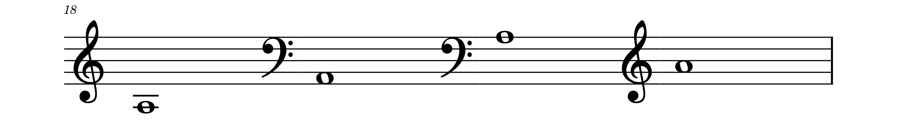
Intervals in A harmonic minor
4th
4th
6th
2nd
7th
Write in the missing degrees of the scale of A harmonic minor

Slide 23
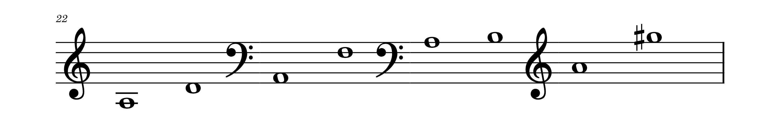
Intervals in A harmonic minor
4th
6th
2nd
7th
Remember to sharpen the 7th degree of the harmonic minor scale

Slide 24
Semitones and tones in the harmonic minor scale
The semitones in the harmonic minor scale are between the:
2nd and 3rd degree,
5th and 6th degree,
7th and 8th degree

Slide 25
Semitones and tones
The semitones remain at the same degrees even when the scale is descending. Only remember to count degrees from the lowest to the highest note.

Slide 26
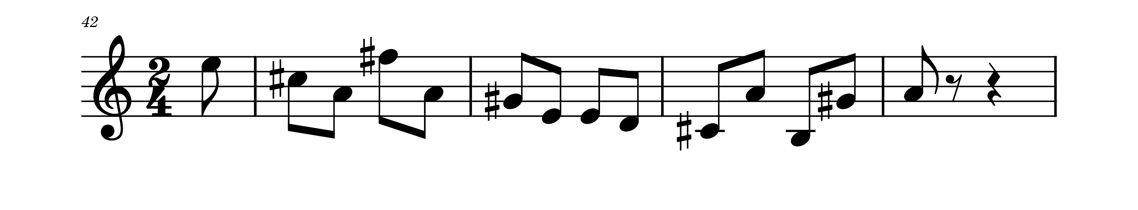
What is the key of the melody below?
The Key is A Major

Slide 27
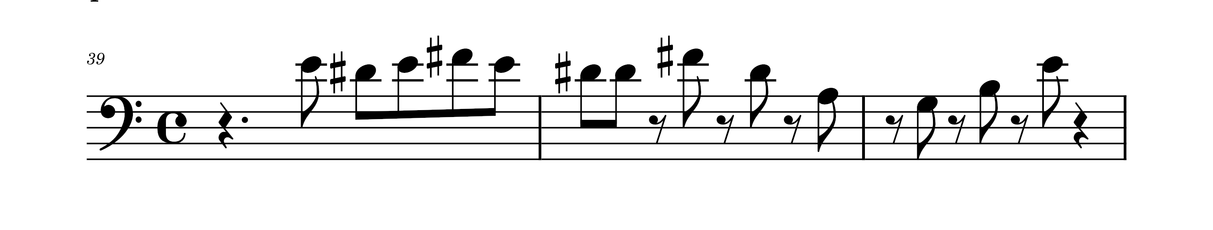
What is the key of the melody below?
The Key is E Minor

Slide 28
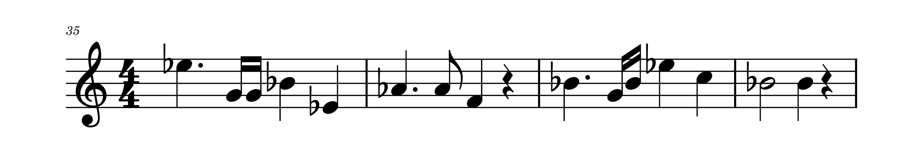
What is the key of the melody below?
The Key is A flat Major

Slide 29
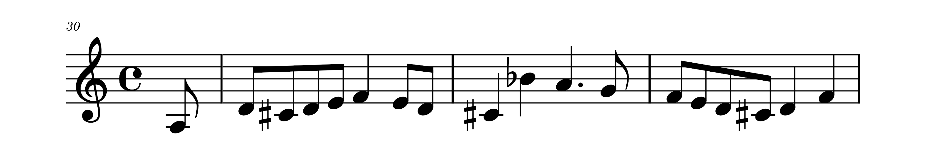
What is the key of the melody below?
The Key is D minor

Slide 30
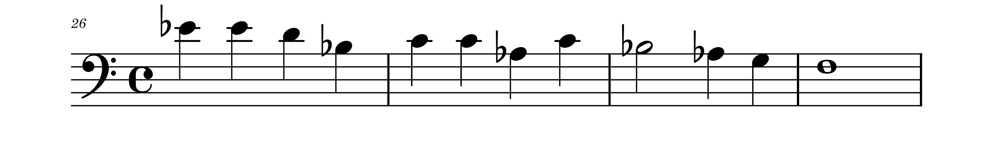
What is the key of the melody below?
The Key is A flat Major

Slide 31
Remember:
The semitones in harmonic minor scale are found between the 2nd and 3rd degree, the 5th and the 6th degree, and between the 7th and 8th degree.
Square brackets will be used in the next slides to show where semitones are found in the scales.

Slide 32
Thank you, Friends
Quiz: www.chezamusicschool.co.ke/mtg2l4

