Slide 1
LESSON 3
Music Theory G1
Quiz: www.chezamusicschool.co.ke/mtg1l3

Slide 2
CONTENTS
Rhythm
01
02
Pitch
Rhythm 2
03
04
Pitch 2

Slide 3
CONTENTS
Rhythm 3
05
06
Scales
Keys & Key Signatures
07
08
Intervals

Slide 4
CONTENTS
Tonic Triads
09
10
Terms & Signs

Slide 5
05
Rhythm Part 3
Grade 1
TIES
WRITING TIES
DOTTED NOTES
GROUPING DOTTED NOTES

Slide 6
Terms & Signs for the day:
Allegro - quick
Allegretto - fairly quick
Moderato - At a moderate speed
Andante - At a medium speed
Adagio - Slow
Accelerando (accel.)- gradually getting quicker
Rallentando (rall.)- Gradually getting slower
Ritardando(rall.)- Gradually getting slower
a tempo- in time (resume the original speed)

Slide 7
Ties
A tie is a musical symbol. It consists of a curved line that connects two notes of the same pitch.
A tie joins two notes by connecting their heads together.

Slide 8
Ties
Notes joined by a tie are played as one note lasting the length of the tied notes added together.
For example, the two minims joined together as shown below will sound like one semibreve.
=

Slide 9
Why would you want to use a tie?
Ties are used to join together notes across a bar-line
The first crotchet of the second bar is joined to the last crotchet of the first bar to make them sound like a minim.

Slide 10
Why would you want to use a tie?
Ties are used to join together notes across the middle beats of a bar in 4/4
The second and third beat of a 4/4 bar have special rules that we will learn later. For now, imagine that there’s an invisible barline before the third beat.

Slide 11
Adding tied notes values
What is the total number of crotchet beats for each of the following tied notes?
A crotchet is one count and a minim is two counts. When a crotchet is tied to a minim, that makes 1 + 2 which equals 3.
So there are 3 crotchet beats tied

Slide 12
Adding tied notes values
What is the total number of crotchet beats for each of the following tied notes?
A crotchet is one count and a quaver is half count. When a crotchet is tied to a quaver, that makes 1 + 1/2 which equals 1 and 1/2 beats. So there are 1 & 1/2 crotchet beats tied

Slide 13
Adding tied notes values
What is the total number of crotchet beats for each of the following tied notes?
A quaver is half count. When a quaver is tied to another quaver, that makes 1/2 + 1/2 which equals 1 beat. So there is 1 crotchet beat tied

Slide 14
Adding tied notes values
What is the total number of crotchet beats for each of the following tied notes?
A minim is two beats. When a minim is tied to another minim, that makes 2 + 2 which equals 4. The tied notes above have a total count of 4 crotchet beats.

Slide 15
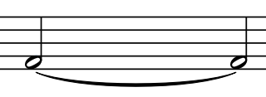
Adding tied notes values
Which one note will show the total value of the tied notes below?
The above will have the same duration as a semibreve

Slide 16
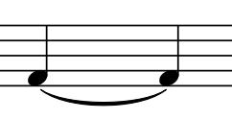
Adding tied notes values
Which one note will show the total value of the tied notes below?
The above will have the same duration as a minim

Slide 17
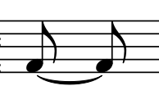
Adding tied notes values
Which one note will show the total value of the tied notes below?
The above will have the same duration as a crotchet

Slide 18
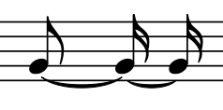
Adding tied notes values
Which one note will show the total value of the tied notes below?
The above will have the same duration as a crotchet
Notice how more than two notes are tied

Slide 19
Adding tied notes values
Which one note will show the total value of the tied notes below?
The above will have the same duration as a semibreve
Notice how more than two notes are tied

Slide 20
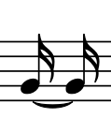
Adding tied notes values
Which one note will show the total value of the tied notes below?
The above will have the same duration as a quaver

Slide 21
Dotted notes
Joining notes with a tie is sometimes not appropriate. It is only in special situations like joining notes across bar-lines that we use ties.
When a note is joined to another note that is half of its value, there is another way of notating it.

Slide 22
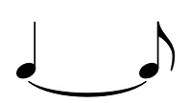
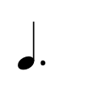
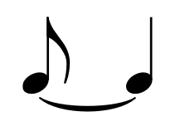
Dotted notes
Instead of joining a crotchet and a quaver as shown below,
Add a dot to the crotchet and that is it.
=

Slide 23
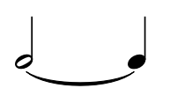
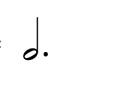
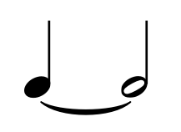
Dotted notes
Instead of joining a minim and a crotchet as shown below,
Add a dot to the minim and that is it.
=

Slide 24
Dotted notes
Instead of joining a minim and a crotchet as shown below,
Add a dot to the minim and that is it.
=

Slide 25
Adding tied notes values
Look for a bar that is incomplete and add a dot where necessary to make it a complete bar
Look at the third bar. There are three beats. If we add a dot to the minim, we will get a dotted minim which is equivalent to three crotchet beats. If we add the crotchet, the bar will be complete.

Slide 26
Adding tied notes values
Below is the correct way to make the third bar complete.

Slide 27
Adding tied notes values
Look for a bar that is incomplete and add a dot where necessary to make it a complete bar
Look at the second bar. The bar is missing a quaver to be complete. We need to add a dot to a crotchet, but which crotchet?
Consider grouping of notes when choosing the crotchet to dot.

Slide 28
Adding tied notes values
Below is the correct way to make the second bar complete.

Slide 29
Adding tied notes values
Look for a bar that is incomplete and add a dot where necessary to make it a complete bar
Look at the third bar. The bar is missing a quaver to be complete. We need to add a dot to a crotchet, but which crotchet?
Consider grouping of notes when choosing the crotchet to dot.

Slide 30
Adding tied notes values
Below is the correct way to make the third bar complete.

Slide 31
Adding tied notes values
Look for a bar that is incomplete and add a dot where necessary to make it a complete bar
1. Look at the second bar. It is short of a full 2/4 bar by a semiquaver. We need to add a dot to a quaver. Which quaver?
2. Look at the last bar. The bar is missing a quaver to be complete. We need to add a dot to a crotchet.

Slide 32
Adding tied notes values
Below is the correct way to make the second and last bar complete.

Slide 33
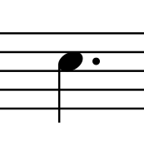
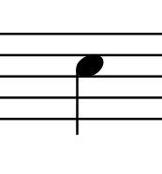
Note values
Below is an order of notes from long to short

Slide 34
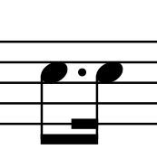
Grouping dotted notes
We learned earlier that quavers and semiquavers are beamed together so that they are grouped into beats
The same is true of dotted notes: If a dotted quaver and a semiquaver are part of the same beat, they are beamed together as shown above.

Slide 35
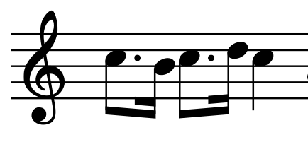
Grouping dotted notes
The bar shown below is correctly grouped
Note the groupings that make single crotchet beats.

Slide 36
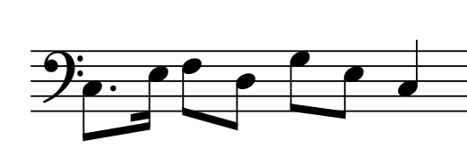
Grouping dotted notes
Is the bar shown below grouped correctly?
0
0
The notes are grouped correctly.

Slide 37
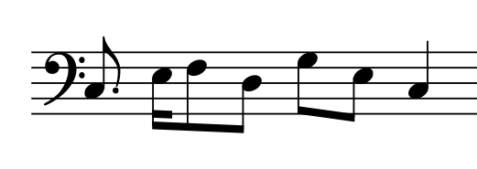
Grouping dotted notes
Is the bar shown below grouped correctly?
0
0
0
0
The notes are not grouped correctly.

Slide 38
Grouping dotted notes
Look at the following rhythm and how it should be written with correct grouping. Note the 4 quavers adding up to a minim
0
0

Slide 39
06
Scales
Grade 1
THE SCALE OF C MAJOR
THE DEGREES OF THE SCALE
TONES AND SEMITONES IN SCALES

Slide 40
Scales we will learn in Grade 1
A scale is a ‘ladder’ of notes that move in step. It can go up (ascending) or come down (descendint). In grade 1, we will learn the scales of the following keys.
C Major
G Major
C
G
C Major scale starts and ends with C. It has got no accidentals
G Major scale starts and ends with G. It has got one sharp on F.
D Major
D
F
F Major
D Major scale starts and ends with D. It has two shaprs on F and C
F Major scale starts and ends with F. It has got one flat on B

Slide 41
Scales
The scale of a key contains all of the notes that belong in that key.
The scale of C major has got no sharps or flats.
The following is C Major scale ascending on both clefs

Slide 42
Scales
The following is C Major scale descending on both clefs

Slide 43
Degrees of the scale
- The notes in a scale are known as degrees
- The first and last notes of the scale (whether ascending or
descending are the same and are the most important.
They’re called the tonic or keynote
- All the degrees in a scale are numbered in relation to the tonic, which is the 1st and 8th degree.
- When descending, the degrees are counted backwards.

Slide 44
Scales
The figure above illustrates the degrees of the scale. The scale is C major ascending on the treble / G clef.

Slide 45
Scales
The figure above illustrates the degrees of the scale. The scale is C major ascending on the bass / F clef

Slide 46
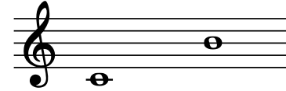
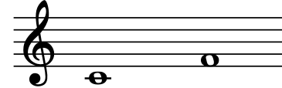
In the following pairs of notes, the first is the tonic. Can you find the degree of the second note?
5th
6th
7th
4th

Slide 47
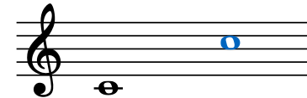
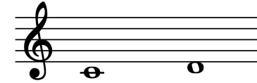
In the following pairs of notes, the first is the tonic. Can you find the degree of the second note?
8th
3rd
2nd

Slide 48
Tones and semitones in scales
Tone
Tone
Semitone
Tone
Tone
Tone
Semitone
- The distance between each note in a major scale is either a tone or a semitone.
- In every major scale, no matter the key, the pattern of tones and semitones is the same.
- The distance between the 3rd and 4th degrees and 7th and 8th degrees is a semitone
- The distance between all other consecutive degrees is a tone.

Slide 49
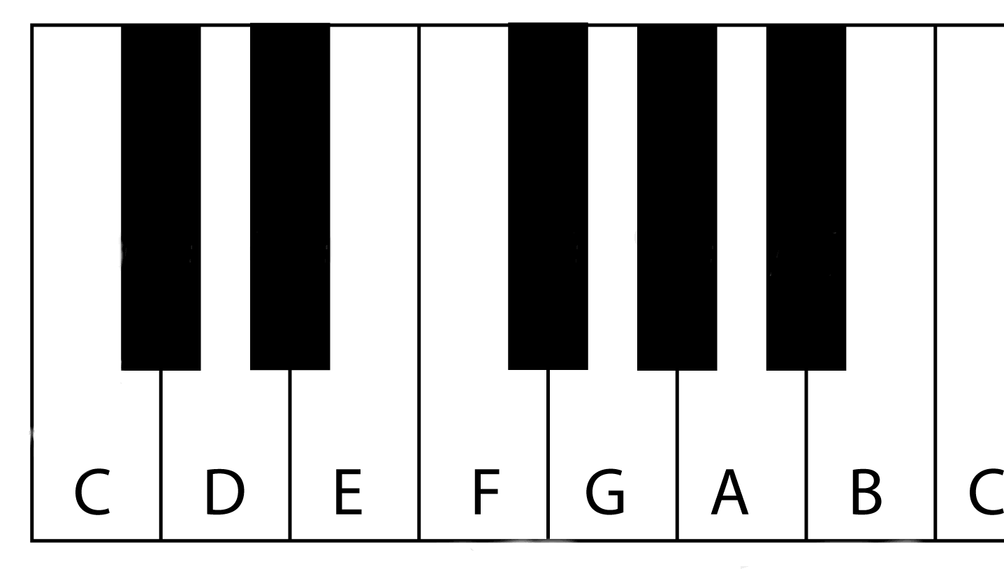
Degrees
Notes
Distance
Tone
Tone
Semitone
Tone
Tone
Tone
Semitone

Slide 50
Thank you, Friends
Quiz: www.chezamusicschool.co.ke/mtg1l3

