Slide 1
LESSON 3
Music Theory G2
Quiz: www.chezamusicschool.co.ke/mtg2l3

Slide 2
CONTENTS
Pitch
01
02
Rhythm 1
Rhythm 2
03
04
Rhythm 3

Slide 3
CONTENTS
Keys & Scales 1
05
06
Keys & Scales 2
Intervals
07
08
Tonic Triads

Slide 4
CONTENTS
Terms and Signs
09

Slide 5
Terms & Signs for the day:
Give the note slight pressure
Slightly separated
Staccatissimo - very detatched indeed
Strong accent - play the note with strong emphasis

Slide 6
05
Keys and Scales
Grade 2
THREE NEW MAJOR KEYS
THE SCALES OF THE 3 NEW KEYS
INTRODUCTION TO RELATIVE MINOR KEYS

Slide 7
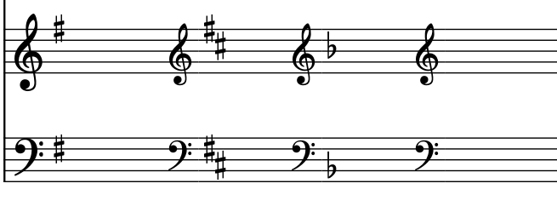
Previous Major keys
The keys we have done before are G major (1 sharp), D major (2 sharps), F major (1 flat) and C major (no sharps or flats).

Slide 8
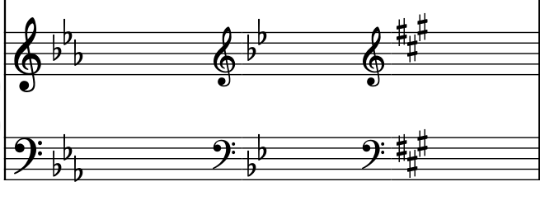
The new keys in grade 2:
E flat major - 3 flats
B flat major - 2 flats
A major - 3 sharps.

Slide 9
Sharps and Flats Order
When writing sharps, we write F sharp, C sharp then G sharp.
When writing flats, we write B flat, E flat then A flat.
They are written in zig-zag pattern.

Slide 10
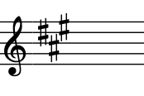
Is the key signature below written correctly?
No, the sharps are on D sharp A sharp and E sharp.

Slide 11
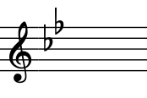
Is the key signature below written correctly?
No, the flats are C flat and F flat.

Slide 12
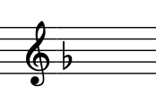
Is the key signature below written correctly?
No, the flat is on G

Slide 13
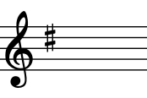
Is the key signature below written correctly?
No, the sharp is on D

Slide 14
Remember: The semitones in every major scale are found between the 3rd and 4th degree, and between the 7th and 8th degree.
Square brackets will be used in the next slides to show where semitones are found in the scales.

Slide 15
What is the key of the scale written below?
The notes with flats are B flat and E flat.
This is an ascending scale of B flat major.

Slide 16
What is the key of the scale written below?
The notes with flats are B flat and E flat.
This is an ascending scale of B flat major.

Slide 17
What is the key of the scale written below?
The notes with flats are B flat and E flat.
This is a descending scale of B flat major.

Slide 18
What is the key of the scale written below?
The notes with flats are B flat and E flat.
This is a descending scale of B flat major.

Slide 19
With key signature
With key signature, you don’t need to add accidentals to the notes.

Slide 20
What is the key of the scale written below?
The notes with flats are B flat, E flat and A flat.
This is an ascending scale of E flat major.

Slide 21
What is the key of the scale written below?
The notes with flats are B flat, E flat and A flat.
This is an ascending scale of E flat major.

Slide 22
What is the key of the scale written below?
The notes with flats are B flat, E flat and A flat.
This is a descending scale of E flat major.

Slide 23
What is the key of the scale written below?
The notes with flats are B flat, E flat and A flat.
This is a descending scale of E flat major.

Slide 24
With key signature
With key signature, you don’t need to add accidentals to the notes.

Slide 25
What is the key of the scale written below?
The notes with sharps are F sharp, C sharp and G sharp.
This is an ascending scale of A major.

Slide 26
What is the key of the scale written below?
The notes with sharps are F sharp, C sharp and G sharp.
This is an ascending scale of A major.

Slide 27
What is the key of the scale written below?
The notes with sharps are F sharp, C sharp and G sharp.
This is a descending scale of A major.

Slide 28
What is the key of the scale written below?
The notes with sharps are F sharp, C sharp and G sharp.
This is a descending scale of A major.

Slide 29
With key signature
With key signature, you don’t need to add accidentals to the notes.

Slide 30
What is the letter name of the 6th degree of A major?
F sharp

Slide 31
What is the letter name of the 7th degree of A major?
G sharp

Slide 32
What is the letter name of the 4th degree of A major?
D

Slide 33
What is the letter name of the 3rd degree of A major?
C sharp

Slide 34
What is the letter name of the 4th degree of
E flat major?
A flat

Slide 35
What is the letter name of the 5th degree of
E flat major?
B flat

Slide 36
What is the letter name of the 2nd degree of
E flat major?
F

Slide 37
What is the letter name of the 7th degree of
E flat major?
D

Slide 38
What is the letter name of the 4th degree of
B flat major?
E flat

Slide 39
What is the letter name of the 6th degree of
B flat major?
G

Slide 40
What is the letter name of the 2nd degree of
B flat major?
C

Slide 41
Thank you, Friends
Quiz: www.chezamusicschool.co.ke/mtg2l3

