Slide 1
LESSON 1
Music Theory G2
Quiz: www.chezamusicschool.co.ke/mtg2l1

Slide 2
CONTENTS
Pitch
01
02
Rhythm 1
Rhythm 2
03
04
Rhythm 3

Slide 3
CONTENTS
Keys & Scales 1
05
06
Keys & Scales 2
Intervals
07
08
Tonic Triads

Slide 4
CONTENTS
Terms and Signs
09

Slide 5
Terms & Signs for the day:
fp (fortepiano)- loud, then immediately quiet
presto - fast (quicker than allegro)
vivace, vivo - lively, quick
lento - slow (slower than adagio)
largo - slow, stately. (same as or slower than lento)
grave - very slow, solemn
piu mosso - more movement, quicker
meno mosso - less movement, slower
ritenuto (riten, rit) - getting slower; held back
con moto - with movement
allargando - broadening
dal segno (D.S) - repeat from the sign

Slide 6
01
Pitch
Grade 2
LEDGER LINES
REWRITING NOTES IN TREBLE CLEF
REWRITING NOTES IN BASS CLEF

Slide 7
Notes
Semibreve
Minim
Crotchet
Quaver
Semiquaver
Whole note
Half note
Quarter note
8th note
16th note

Slide 8
Ledger lines
Middle C is placed on a ledger line below the treble clef
Apparently, middle C is not the only note that is written on a ledger line
There are other letters above
G that need ledger lines too.
There are other letters below
middle C that need ledger lines
Middle C

Slide 9
Ledger lines
Middle C is placed on a ledger line above the bass clef
In grade 2 we are going to learn notes up to the 2nd ledger line above and below the clefs
There are other letters above
Middle C that need ledger lines
There are other letters below
E that need ledger lines
Middle C

Slide 10
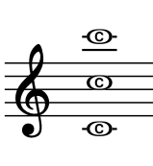
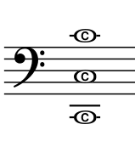
Ledger lines
- Learning the position of the Cs on the bass clef is important.
- Note the C on the 2nd ledger line and on the 2nd space
Middle C
- Learning the position of the Cs on the treble clef is important.
- Note the C on the 2nd ledger line and on the 4th space

Slide 11
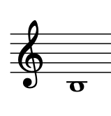
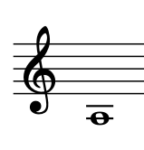
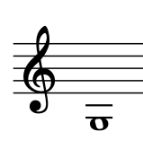
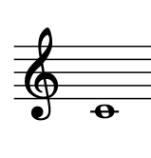
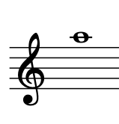
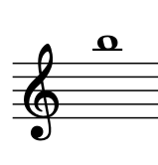
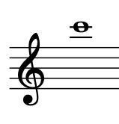
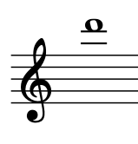
Ledger lines
C
B
A
G
A
B
C
D

Slide 12
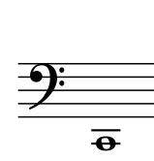
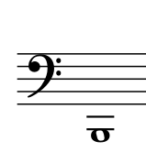
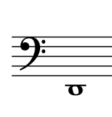
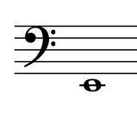
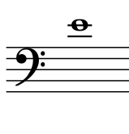
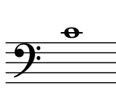
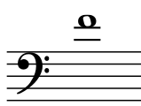
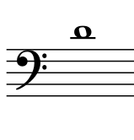
Ledger lines
C
E
B
D
E
C
F
D

Slide 13
Writing notes on the same pitch using another clef
Notice how the Bass clef fits in with treble clef ledger lines. The second ledger line below the treble clef is another way of writing the A on the last line of the bass clef.

Slide 14
Writing notes on the same pitch using another clef
Notice how the Treble clef fits in with bass clef ledger lines. The second ledger line above the bass clef is another way of writing the E on the first line of the treble clef.

Slide 15
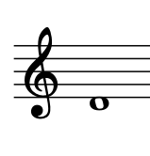
Which of the treble clef notes is in the same pitch as the one shown on bass clef below?
Middle C plays a vital role in showing which direction to go to write the same note on another staff. Just ask yourself, how far from middle C? and, in which direction?
The note on the bass clef is a step above middle C. So the note that is a step above middle C on the treble clef is the correct answer.

Slide 16
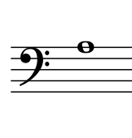
Which of the bass clef notes is in the same pitch as the one shown on treble clef below?
Middle C plays a vital role in showing which direction to go to write the same note on another staff. Just ask yourself, how far from middle C? and, in which direction?
The note on the treble clef is 2 steps below middle C. So the note that is 2 steps below middle C on the bass clef is the correct answer.

Slide 17
The melody above, for example, when written on the treble clef, should be:
And not
The second is an octave above the original melody. Take note of the middle C

Slide 18
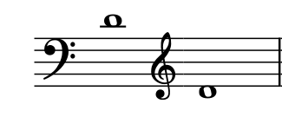
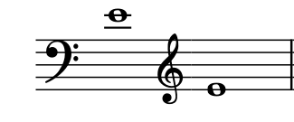
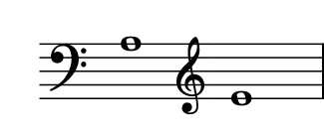
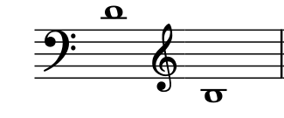
These notes are on the same pitch, though on a different clef
These notes are NOT on the same pitch. Use middle C to find out why

Slide 19
02
Rhythm
Grade 2
TIME SIGNATURES WITH A MINIM BEAT
A TIME SIGNATURE WITH A QUAVER BEAT
REWRITING RHYTHMS IN DIFFERENT METRES

Slide 20
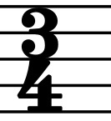
Time signature review
- In a time signature, the top number tells us the number of beats in each bar.
- The bottom number tells us the value/type of each beat.
- Number 4, for example, in the bottom of a time signature tells us that the beat is a quarter note - a crotchet.
3/4 therefore means 3 crotchet beats in each bar.

Slide 21
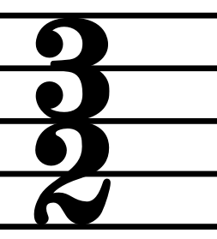
When the bottom number is 2...
- In grade 2, the top number still means the same thing - the number of beats in each bar.
- And the bottom number still tells us the value/type of each beat.
- But what does the 2 mean? - half notes or minims. If you want to remember easily, take note that 4 is a denominator for quarter and 2 is a denominator for half.
3/2 therefore means 3 minim beats in each bar.

Slide 22
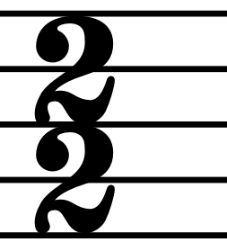
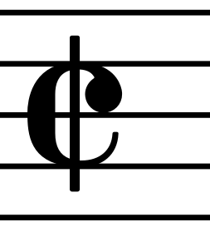
=
- The time signature 2/2 means there are two minims in each bar.
- There is another way of writing the 2/2 time signature, as shown in the image on the top right side of this slide. It is called alla breve

Slide 23
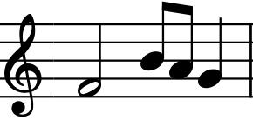
Time signatures with a minim beat
What is the time signature of the above measure?
- Although you will be perfectly correct if you say the time signature of the bar above is 4/4, it is also a perfectly correct 2/2 bar.

Slide 24
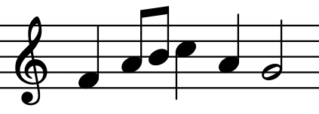
Time signatures with a minim beat
What is the time signature of the above measure?
- The time signatue of the above bar is 3/2 - three minims in each bar.
- Notice each minim beat as shown by the red rectangles.

Slide 25
Time signatures with a minim beat
What is the time signature of the above measure?
- The time signatue of the above bar is 4/2 - four minims in each bar.
- Notice each minim beat as shown by the red rectangles.

Slide 26
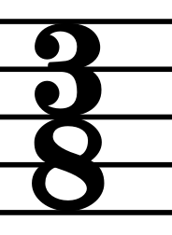
When the bottom number is 8...
- Top number - number of beats in each bar
- Bottom number - value/type of each beat.
- But what does the 8 mean?
- 8 means 8th notes or quavers. If you want to remember easily, take note that 8 is a denominator for eighth, 4 is a denominator for quarter and 2 is a denominator for half.
3/8 therefore means 3 quaver beats in each bar.

Slide 27
When the bottom number is 8...
- The above bars/measures are examples of how three quaver beats in a bar looks like in notation
- Notice the number of quavers in each bar is 3 and everything with flags are beamed together

Slide 28
When the bottom number is 8...
- The above bars/measures are examples of how three quaver beats in a bar looks like in notation
- Notice the number of quavers in each bar is 3 and everything with flags are beamed together

Slide 29
Rewriting rhythms in different metres
It is possible to rewrite rhythms in different time signatures by changing the type of beat.
The thing to keep in mind when writing a rhythm or a section of music in a different metre is the type of beat.
When music is rewritten in a different metre, it sounds exactly the same way.
Think about it, if there are two crotchet BEATS in each bar, or if there are two minim BEATS in each bar, which one of the above has MORE BEATS than the other?

Slide 30
For example, this rhythm, which has four beats in a bar...
... can be rewritten like this, with four minim beats in a bar.
Can you see that in the 4/2 rhythm, the time values have been doubled? Count and see whether there are more than enough beats in any of the bars.

Slide 31
And this 2/2 rhythm, which has two minim beats in a bar...
... can be rewritten like this, with two crotchet beats in a bar.
Can you see that in the 2/4 rhythm, the time values have been halved? Count and see whether there are more than enough beats in any of the bars.

Slide 32
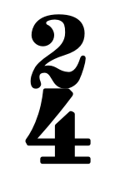
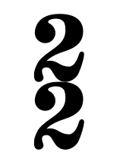
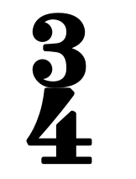
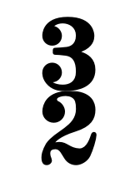
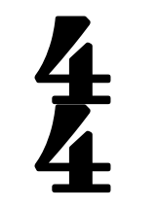
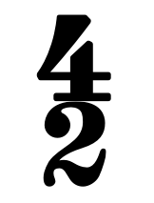
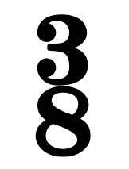
By DOUBLING the time values ...
can be rewritten as
can be rewritten as
can be rewritten as
can be rewritten as

Slide 33
By HALVING the time values ...
can be rewritten as
can be rewritten as
can be rewritten as
can be rewritten as

Slide 34
Rewriting rhythms in different metres
Is the above melody correctly rewritten using notes of half the values?
Take note that the number of beats doesn’t change but the value/type of beats do change.

Slide 35
Thank you, Friends
Quiz: www.chezamusicschool.co.ke/mtg2l1

